Slide 1
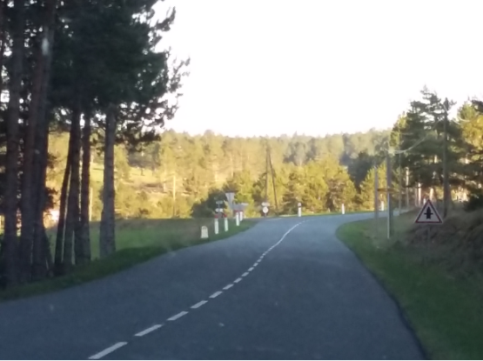
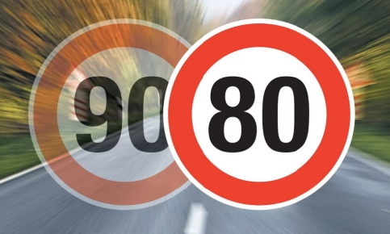
      Reducing the speed limit on the rural network
      in France
French Road Safety Observatory
ETSC – 11 September 2024
Speed and improving the safety of vulnerable
road users
http://www.securite-routiere.gouv.fr

Slide 2
France at a glance
Fatalities on the rural network over 5 years (2012-2016)r
Population : 66 million inhabitants
Area : 600.000 km²
Exposure : 606 billion veh.km
3 700 RT fatalities in 2017
  (incl overseas)
80% population lives in urban areas
63% RT fatalities on rural network
Fewer than 25
Between 25 and 50
Between 50 and 100
Between 100 and 150
Between 150 and 286

Slide 3
Historical background for the speed limit reduction
Political timeline President François HOLLANDE 2012-2017 November 2012 : 2020 target (to reduce fatalities by 50%) set by Minister of Interior June 2014 : National road safety council advises government to experiment a reduced speed limit of 80km/h on rural network July 2015 to July 2017 : experiment on 80km of trunk road network President Emmanuel MACRON 2017-2022 December 2017 : Prime Minister says in the media that from his personal perspective we should decrease the speed limit to 80 km/h 9 January 2018 : Interministerial committee chaired by Prime Minister Edouard Philippe announces 18 new measures. | Scientific timeline 2012-2014 : Cerema study on road accidents according to the type of rural network (2 counties) November 2013 : National road safety council EXPERT COMMITTEE recommends key measures to meet the target. 300 to 400 lives to be saved per year with lowering the speed limit on rural roads from 90 to 80 km/h 2013-2015 : Cerema questionnaire to County Councils about traffic and accidents according to the type of rural network (9 counties with full reply) 2015-2017 : Cerema traffic observations on experiment 2017 : ETSC Reducing deaths in single vehicle collisions 2016-2018 : Socio-eco impact of a 10km/h speed limit reduction on all networks (Min Transport eco experts). Jan-April 2018 : ONISR questionnaire to 100 Prefects on accidents according to the type of rural network 2018 : IRTAD report on Speed and crash risk
http://www.securite-routiere.gouv.fr
80km/h has been in force since 1st July 2018

Slide 4
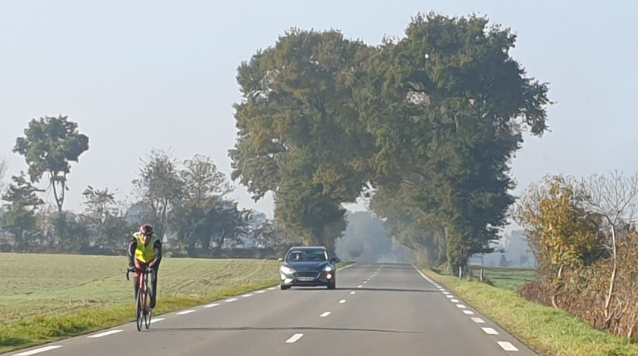

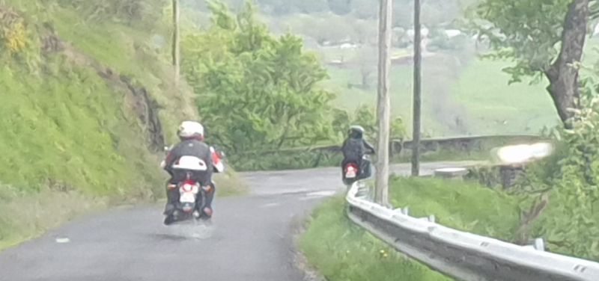
Fatalities occur first on the main rural roads (where most traffic is)
On non-motorway roads outside built-up areas :
38% of fatalities occur on the first 10% main rural roads
55% of fatalities occur on the first 20% main rural roads
64% of fatalities occur on the first 30% main rural roads
There must be no exception to the 80 km/h measure !
We did make an exception when there were overtaking stretches
in 3 or 4 lanes sections but they represented less than 5 000 km
(out of more than 400 000km).

Slide 5
Lesson learnt
On a mature network, fatalities occur where the traffic flows, therefore on the nice and comfortable roads
Setting up a reduction target for fatalities implies targetting where the fatalities occur, and not just where roads have the higher risk i.e :
  Use the number of fatalities (or seriously injured) per km
  And not the number of fatalities (or seriously injured) per veh.km

Slide 6
Fatality trend against population and traffic (excl.overseas)
Development of the number of fatalities per million inhabitants over the past 15 years
Fatality trend (red), traffic (blue), and number of fatalities per billion veh.km (green) since 1952
- Setting up speed limits
- Implementing automated speed cameras

Slide 7

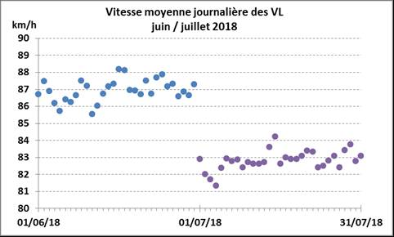
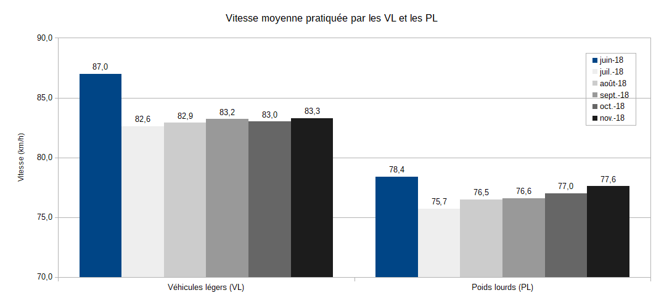
Average speed changes before and after (June to November 2018)
Passenger cars average daily speeds in June and July 2018
From a dedicated Cerema traffic observatory
(50 permanent traffic/speed counts)
A sudden drop of passenger cars driving speeds from the very 1st July 2018, although it was a Sunday
The decrease on average driving speeds for passenger cars and heavy goods vehicles :
  -3.9 km/h for passenger cars between June and September
  -1.8 km/h for HGV between June and September (their speed limit was already max 80km/h)
Passenger cars (left) and HGV (right) mean speeds from June (blue) to November (black) 2018

Slide 8
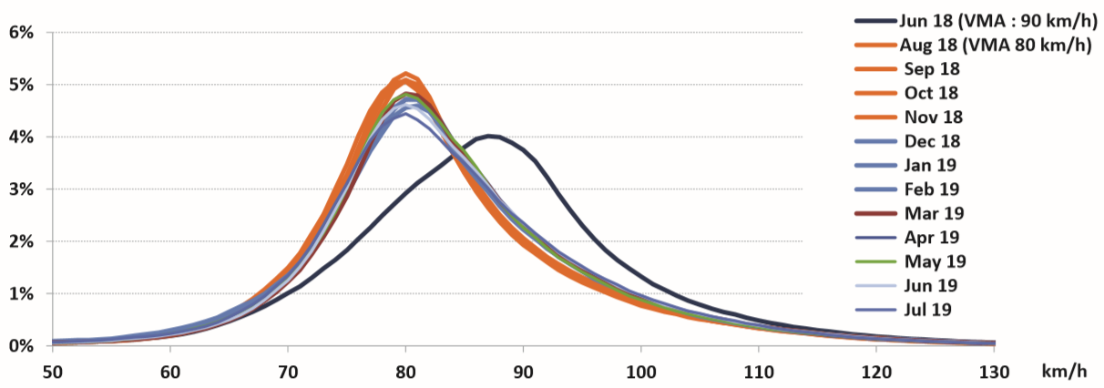
Driving speeds changes before (June 2018)/after (August 2018 +)
Speed distribution of passenger vehicles on French two-way roads)
80
90
After period shows :
shift to the left for the whole driving speed distribution
driver behaviour stability once the measure is in place.

Slide 9
Road safety performance on roads outside built-up areas fares better than on remaining network
Gliding 12 months road traffic fatalities in France mainland
1st semester 2018 : falling trend for all networks
2nd semester 2018 :
rural roads fatalities decrease
Fatalities increase on remaining network
Despite weather hazards
and vandalized radars,
1st semester 2019 : rural non-motorway roads fare better than the rest of the
network.

Slide 10
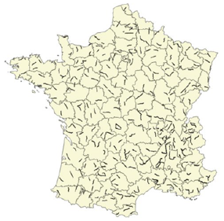
Journey Time follow-up before/after (between June to September 2018)
On average, a travel delay of one second per kilometre over 300 30-km itineraries
34% of itineraries even noticed time saving.
37% of itineraries noticed a travel delay under 1 second per kilometre
12 % have a travel delay
higher than 2s/km.

Slide 11
User survey before/after implementation of the 80 km/h speed limit
Before
Survey end April, 2018, 5,310 respondents aged 18 +, representative of French population
84 % use car as main travel mode on that network
30% are in favour of the measure, 40% against it.
77% intend to comply always or nearly always with 80 km/h.
Reason for not complying very often is that “they like and want to drive fast”.
Time delay rarely quoted.
Survey early March, 2019 (after yellow vest movement)
  25% still totally opposed to 80 km/h (40% before)
  Agreement progressing including among rural people, except for two-wheelers.
  Respondents declare additional travel time generally under 5 minutes.
  For 28%, no journey time difference.
After

Slide 12
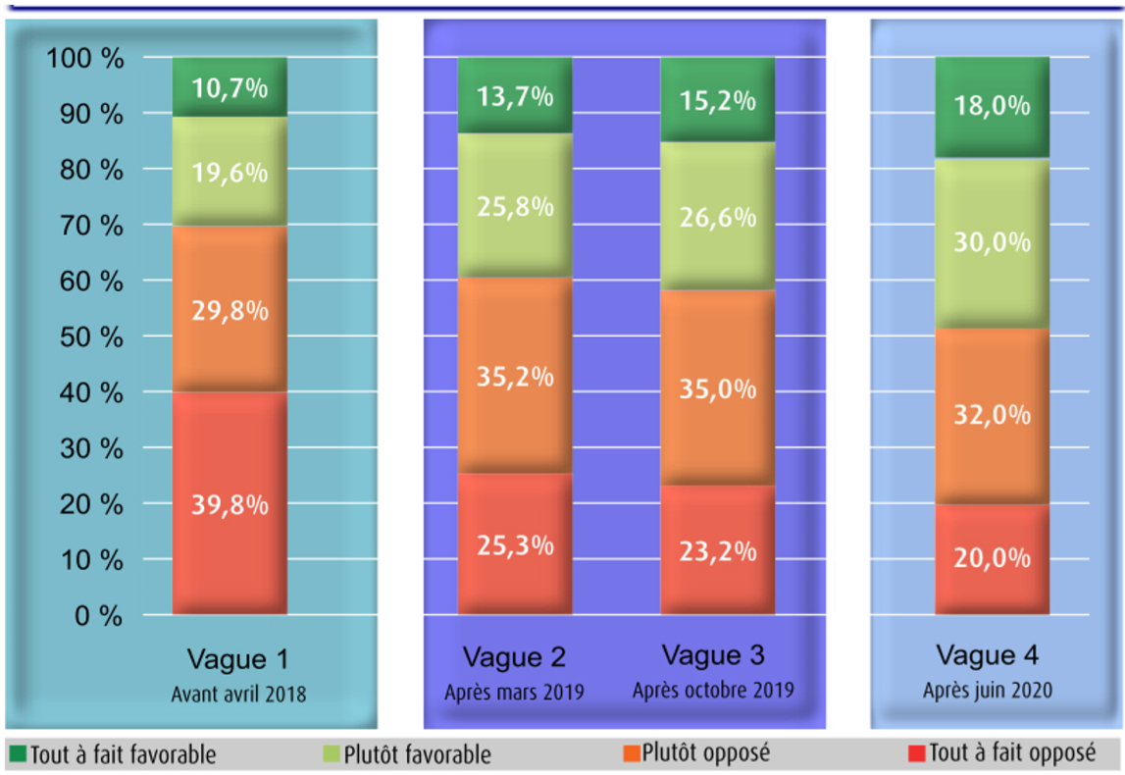
Agreement is progressing among all populations
BEFORE
April 2018
AFTER
March October 2019
AFTER
June 2020
Absolutely in favor
Rather in favor
Rather against
Totally against

Slide 13
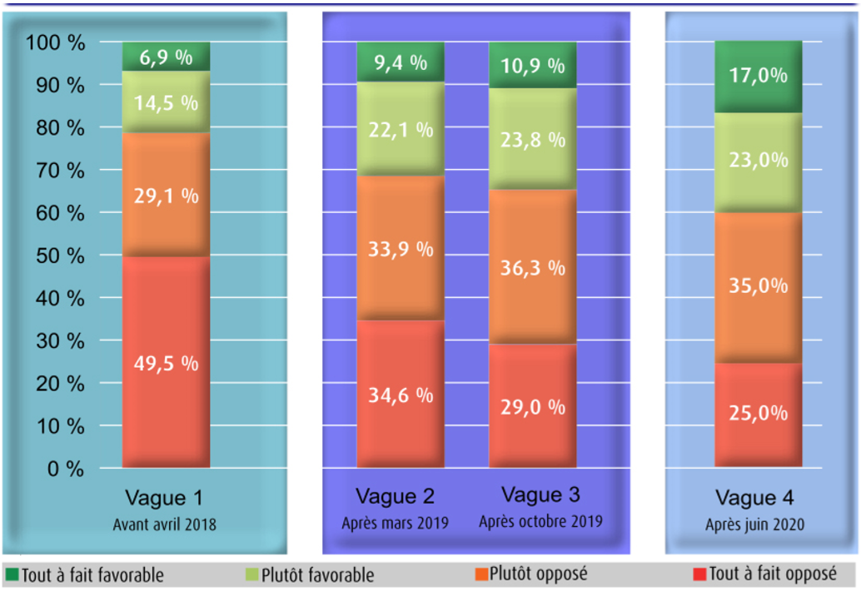
and in particular for people living in rural areas
BEFORE
April 2018
AFTER
March October 2019
AFTER
June 2020
Absolutely in favor
Rather in favor
Rather against
Totally against

Slide 14
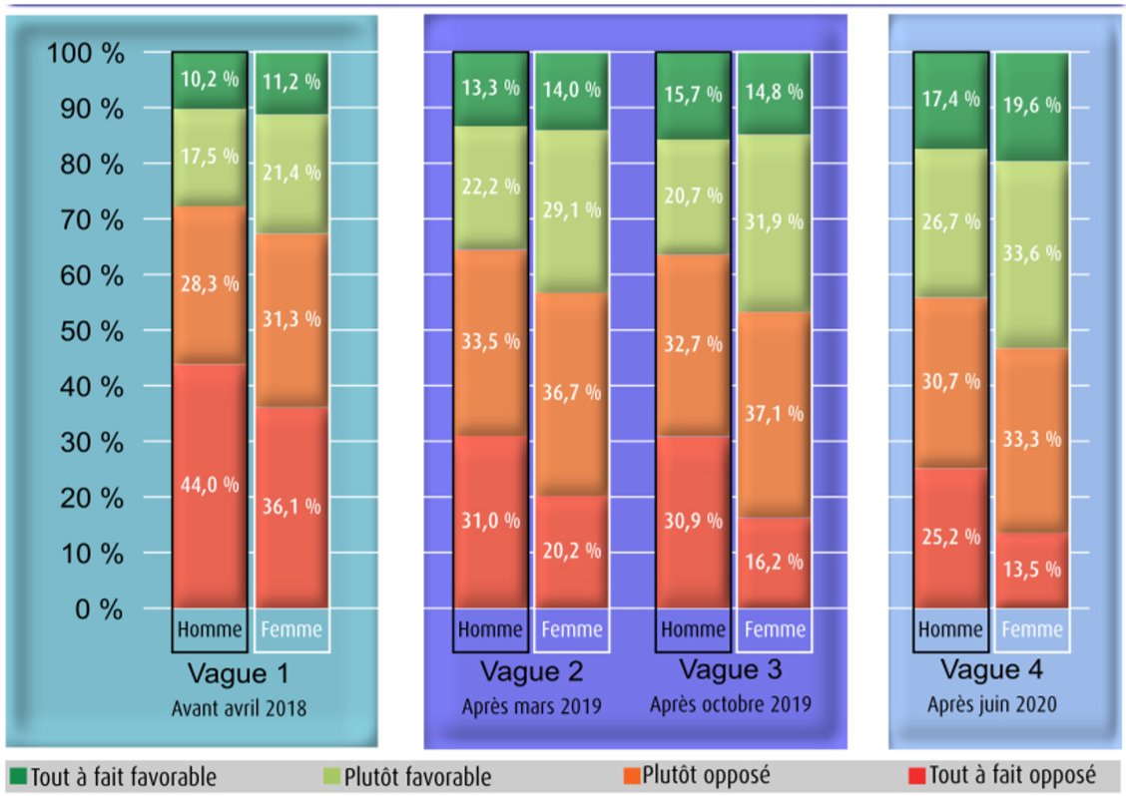
Women agree more often with the new measure than men
Men
Women
Men
Women
Men
Women
Men
Women
BEFORE
April 2018
AFTER
March October 2019
AFTER
June 2020
Absolutely in favor
Rather in favor
Rather against
Totally against

Slide 15

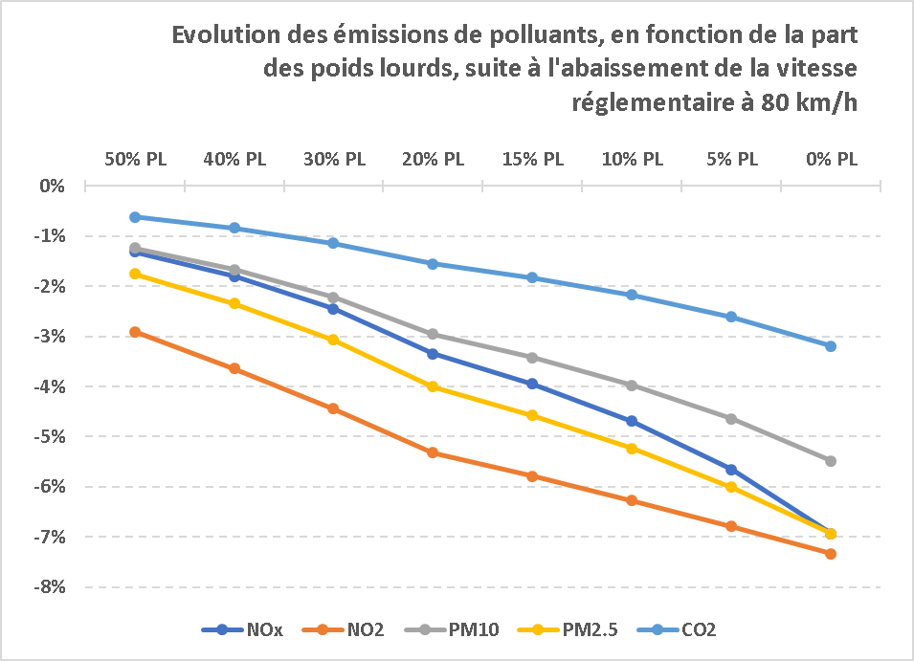
Good news expected also on air pollutant emissions
A study from ATMO Auvergne Rhône-Alpes based on models currently available concerning air pollutants expects that the speed limit reduction will :
reduce greenhouse gases (CO₂)
by 3 % at most
reduce pollutants harmful for our health
(Nitrogen oxide and fine particles) by 7 % at
most. This would benefit the population living
within 50m from rural roads.
The gain decreases as HGV traffic share
increases.
Reduction in air pollutant emissions, according to the share in HGV (PL) traffic, as a result of the reduction of the speed limit to 80 km/h

Slide 16
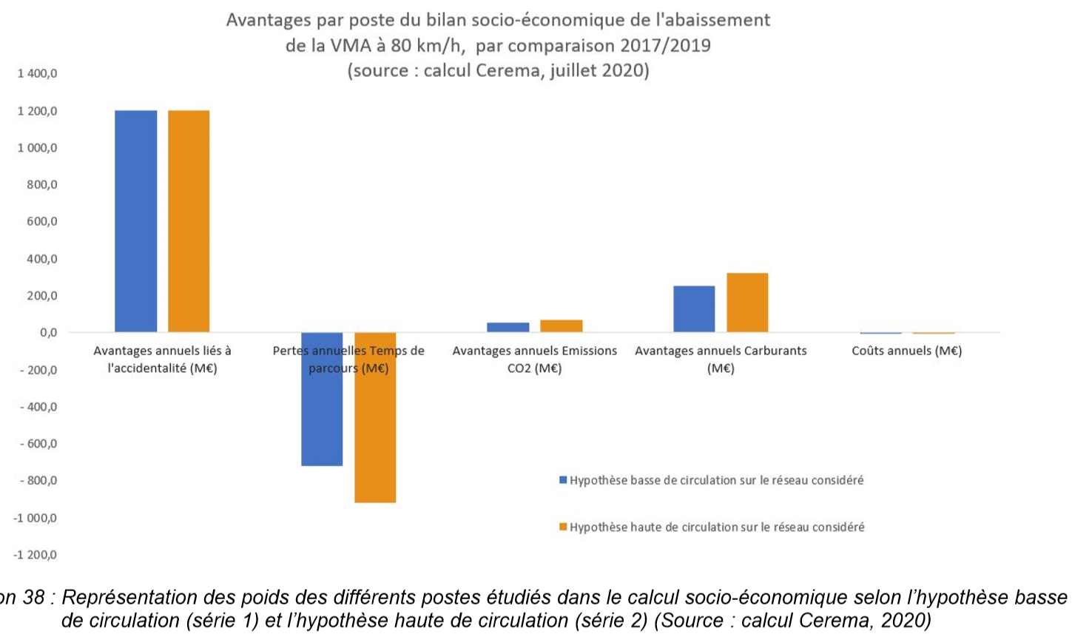
A positive overall socio-economic balance sheet in the order of €700 million per year
Gains and losses composing the socio-economic balance sheet of the 80 km/h measure, in €millions (comparison 2017/2019) (Cerema 2020)
€1,2 billion gain
€300 million gain
€60 million gain
Accidents Time delay CO2 emissions Fuel savings Annual costs
with a low hypothesis for traffic on relevant network
with a high hypothesis for traffic on relevant network
€800 million loss

Slide 17
More than 300 lives were spared over 20 months
A highly effective and low-cost measure
• A strong decrease of fatalities thanks to an overall decrease of practised speeds
• A small journey-time increase of 1 second per km
• An on-going increase in acceptability over time
from 30% in favour to 48%, 2 years later

Slide 18
A difficult way forward : change of law + COVID period
80 km/h : a Prime Minister decision
« New mobility » Act (Dec 2019) : local authorities can raise back to 90 km/h on selected roads :
    Not for the trunk road network (80 km/h)
    Discussions at county level
Risk that roads selected are from the main local network where :
    38% fatalities occur on the first 10% main rural roads
    55% fatalities occur on the first 20% main rural roads
    64% fatalities occur on the first 30% main rural roads
Expert committee advice in July 2019, based on safe system :
https://www.onisr.securite-routiere.interieur.gouv.fr/en/knowledge-centre/road-environment/rural-networks/departure-from-the-80-kmh-speed-limit-decision-support

Slide 19
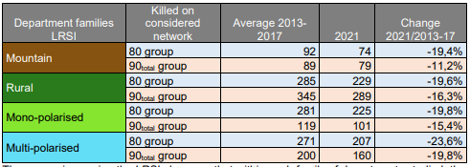
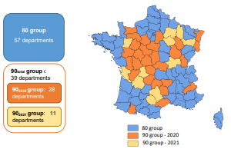
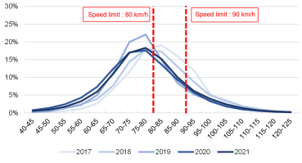
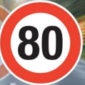
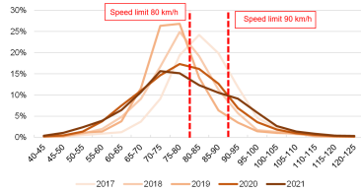

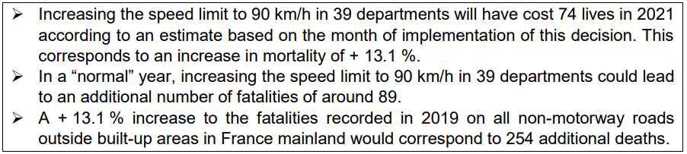

Impact of raising the speed limit to 90 km/h totally or partially in 40% of the counties
More info on ONISR website :
https://www.onisr.securite-routiere.gouv.fr/en/knowledge-centre/evaluation/evaluation-of-the-measures/increasing-the-speed-limit-to-90-kph-on-certain-departmental-roads

Slide 20
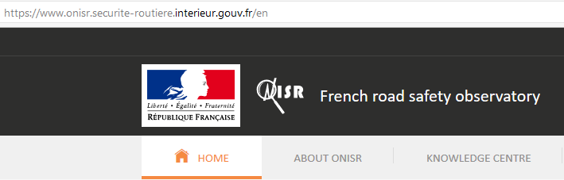
As a conclusion, speed is not like any other factor
Speed (FLAM) : 1st risk factor for fatal accidents outside built-up areas (37 %)
But : speed limit change > decrease in overall speeds > fatal accidents drop whichever the risk factor
Dangerous roads are no longer those we drivers think. Severe crashes occur :
  where the traffic is (main network)
  with free-flow speeds (away from traffic jam)
  without central reserve separation, road users separation, grade-separated crossings (single carriageways)
More info on ONISR website :
https://www.onisr.securite-routiere.interieur.gouv.fr/en/knowledge-centre/evaluation/evaluation-of-the-measures/80-kmh-speed-limit-on-rural-single-carriageways

Slide 21





More information on our website
      https://www.onisr.securite-routiere.gouv.fr/en
Websites to compare countries performance :
      OECD – ITF – IRTAD : https://www.itf-oecd.org/IRTAD
      WHO : https://www.who.int/publications/i/item/9789241565684
      European commission : https://road-safety.transport.ec.europa.eu/statistics-and-analysis_en

