Slide 1
Rolling out a Safety Camera Network in Lithuania
Nemunas Abukauskas
Ministry of Transport and Communications
2024-09-11

Slide 2
Road traffic fatalities in Lithuania since 1945

Slide 3
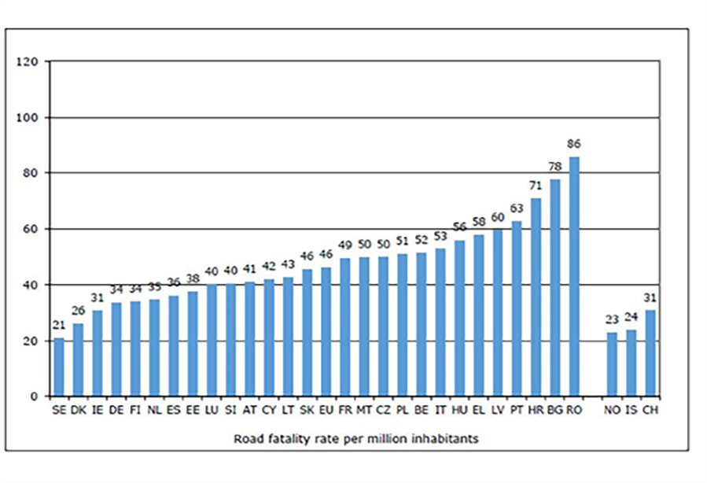
Road fatality statistics 2023, 2010 and 2001 (per 1 million inhabitants)
2001
2010
2023
202
90
43
Road fatality rate per 1 million inhabitants

Slide 4
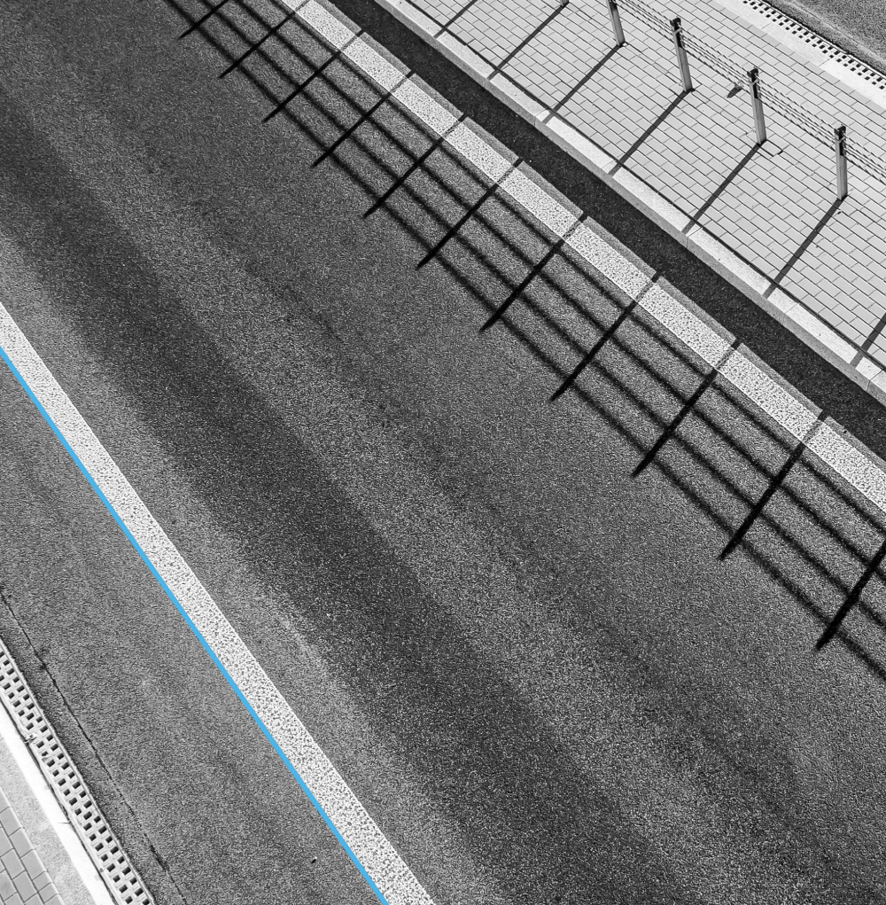
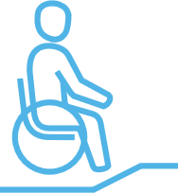
We have implemented more than 1000 road safety measures / per year
Reconstructed unsafe pedestrian crossings
New roundabouts
Engineering upgrading of dangerous junctions
Infrastructure for vulnerable road users
Improvement of lighting conditions
Safety islands, traffic calming, speed bumps
Additional road safety measures
Improving safety of road sides

Slide 5
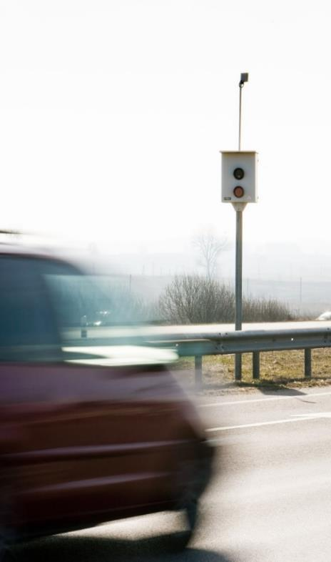
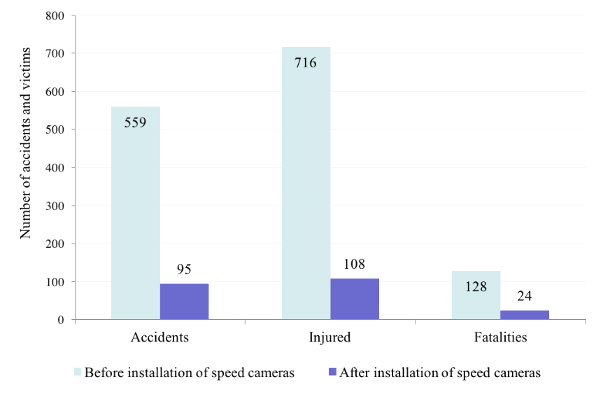
Speed Cameras
First study in 2009. The effectiveness of stationary speed cameras
Unit | Before | After | Change, %
Number of accidents Injured Killed | 559 716 128 | 95 108 24 | – 83,0 – 84,9 – 81,3

Slide 6
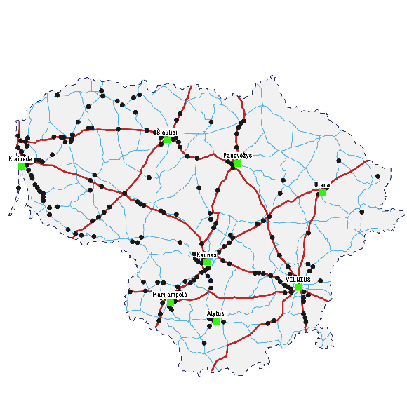
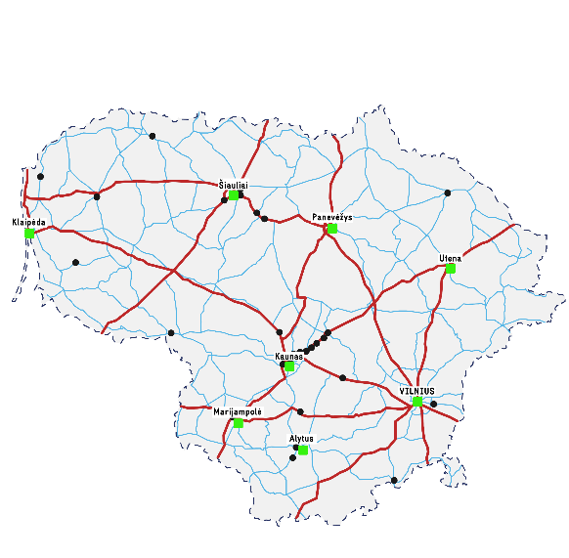
Black spots in Lithuanian roads (per 10 years)
Map of black spots
Deploying of road safety measures helped
to reduce number of black spots by 90%
Black spots
Main and national roads
Regional roads
2020
2006
2016
Black spot – is a location of road where in a section of 500 meters during 4 years at least 4 fatal or injury accidents took place and the accident indicates (accident density and accident coefficient have reached or exceeded the limit values).
Map of black spots
Map of black spots
2022

Slide 7
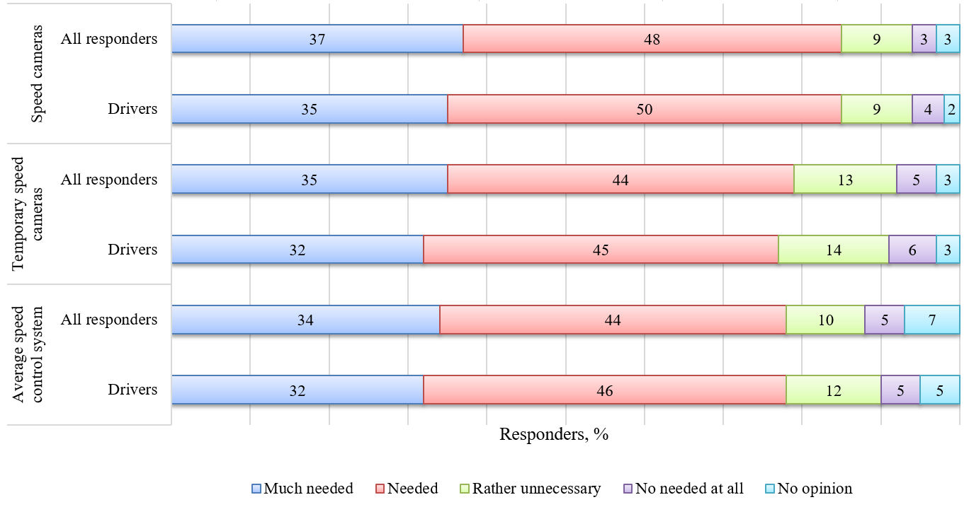
Research II
Second study in 2016. Public opinion
Assesment of automatic speed control (public opinion)

Slide 8
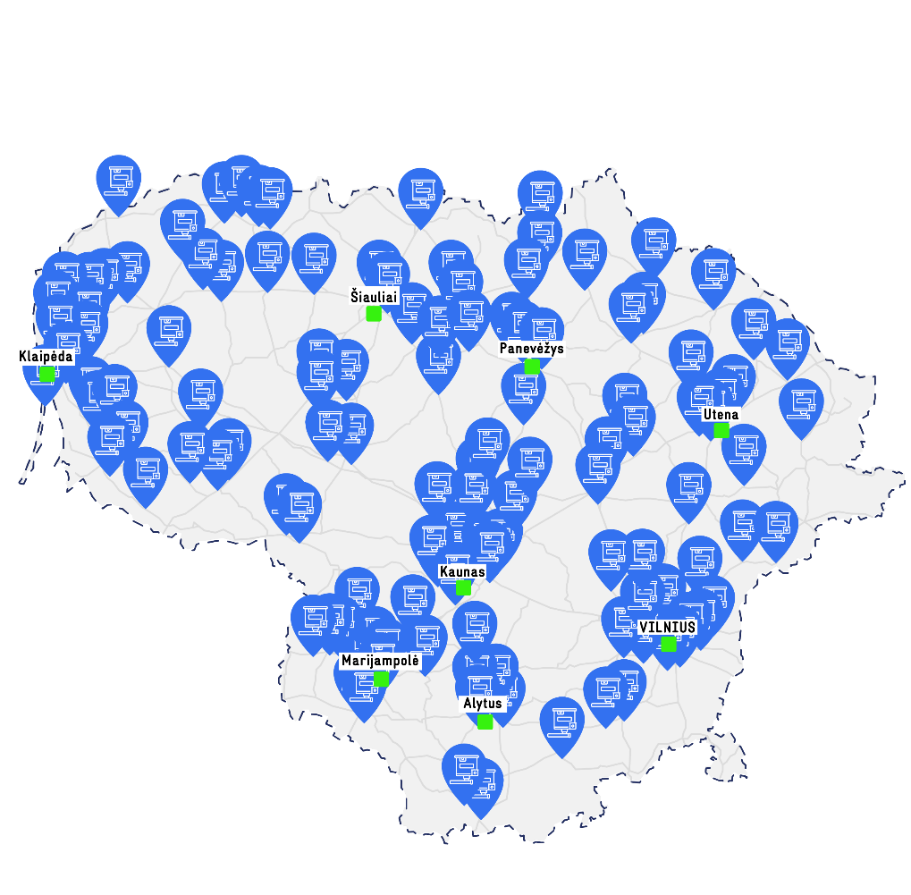
Speed cameras in Lithuanian National road network 2023-2024
2023
135 section control road sections
78 speed cameras
2024
+ 50 new section control road sections

Slide 9
Research III (upcomming)
It is could be that in general speed cams is more effective than section speed control;
Society more dislike section speed control than speed cams (in general society speed cams evaluate as positive measure);
Section speed control needs additional measures to be implemented.

Slide 10
DEVELOPING A CYCLE PATH NETWORK IN LITHUANIA

Slide 11
The situation in 2021:
No data about cycling infrastructure (length, type, conditions, users etc.) (the owners of cycling infrastructure are 60 municipalities and Lithuanian Road Administration (LRA));
It was identified that during the 30 years of independence, infrastructure for bicycles was built chaotically and episodically;
It was identified that there are no clear definitions what is „cycling infrastructure“;
It was identified that there are no criteria for infrastructure network planning;
It was identified that society don‘t have clear opinion on cycling transport;
On the other hand it was identified that infrastructure owners want to develop cycling infrastructure.

Slide 12
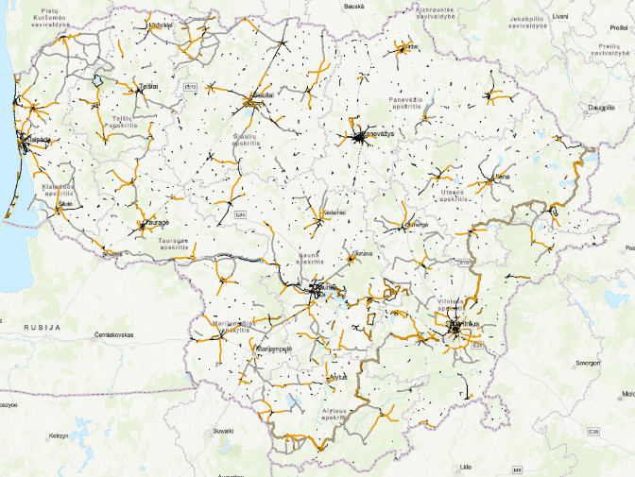
Infrastructure inventorisation
All infrastructure was inventorised in 2021-2022;
Preliminary infrastructure developing plan was made (for state significance roads).

Slide 13
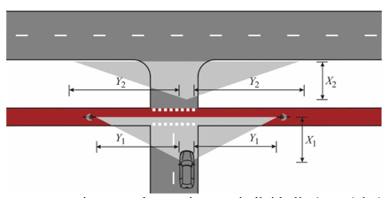
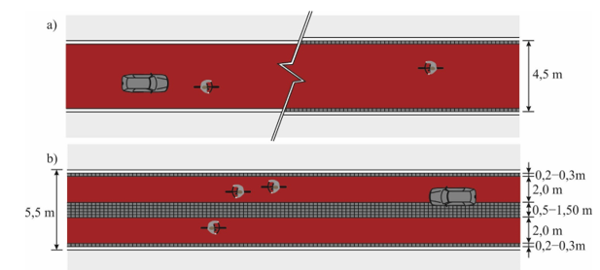
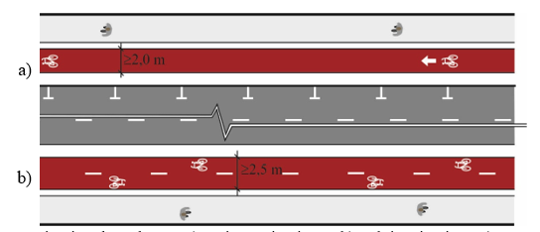
Infrastructure planning and design regulation document has been prepared (Approving process)
Main Goals:
To create general cycling infrastructure network planning process and main planning criteria;
To adopt best practice from different countries experience;
To set clear definitions for cycling infrastructure and main parameters of this infrastructure;
To set sufficient visual infrastructure measures for clear situations between car drivers and cyclists.

Slide 14
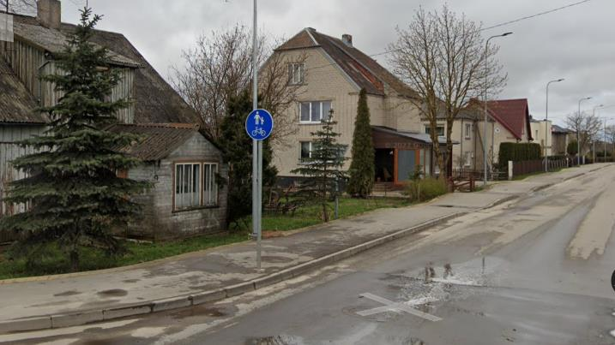
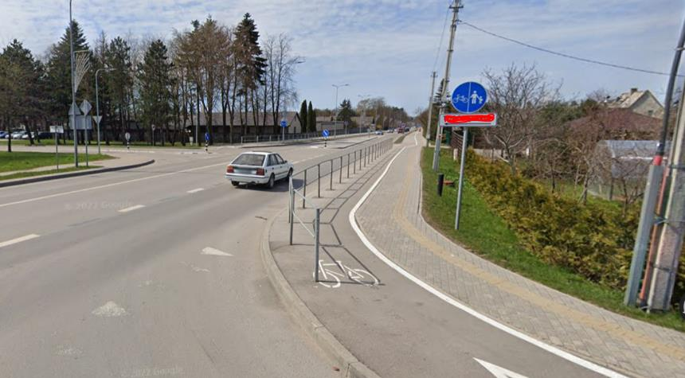
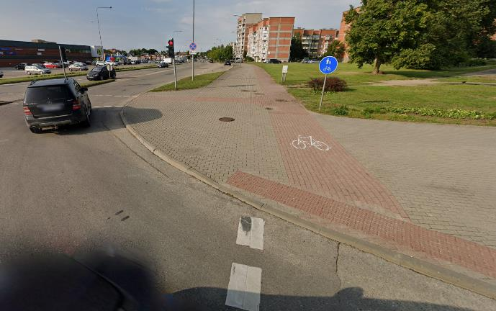
Clear definitions for types of Cycling infrastructure was missing

Slide 15
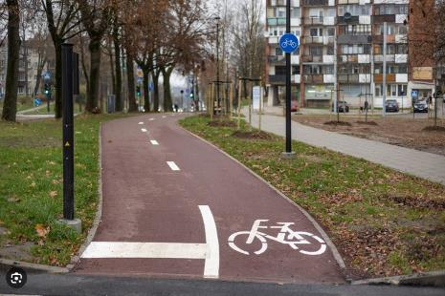
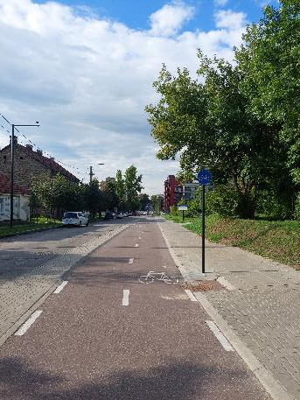
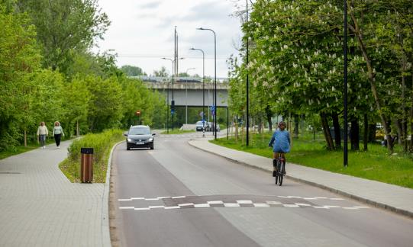
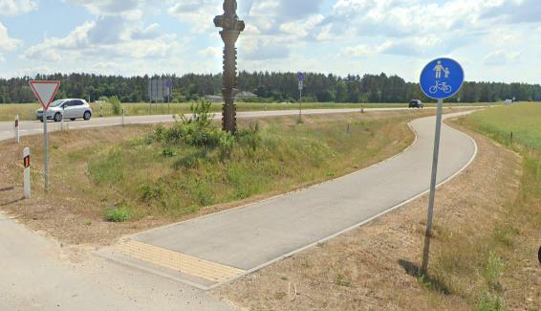
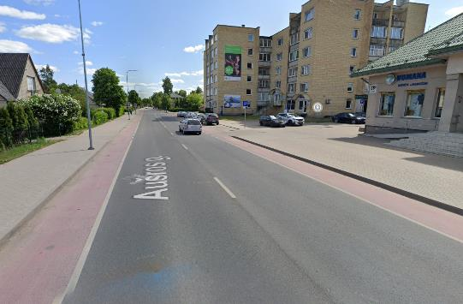
Change: clear definitions for types of Cycling infrastructure

Slide 16
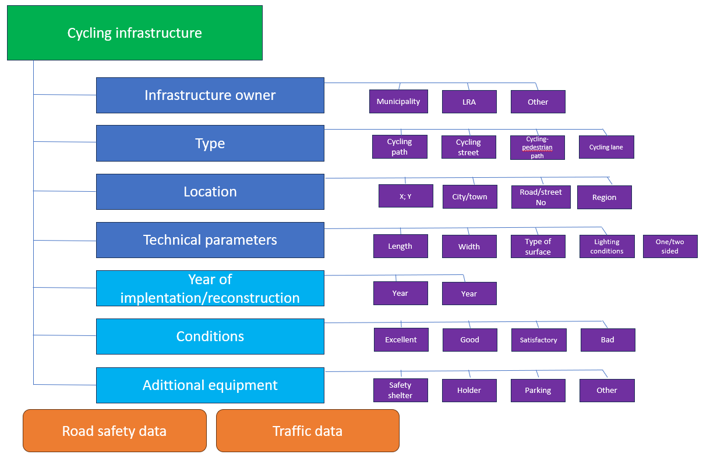
Data platform:

Slide 17
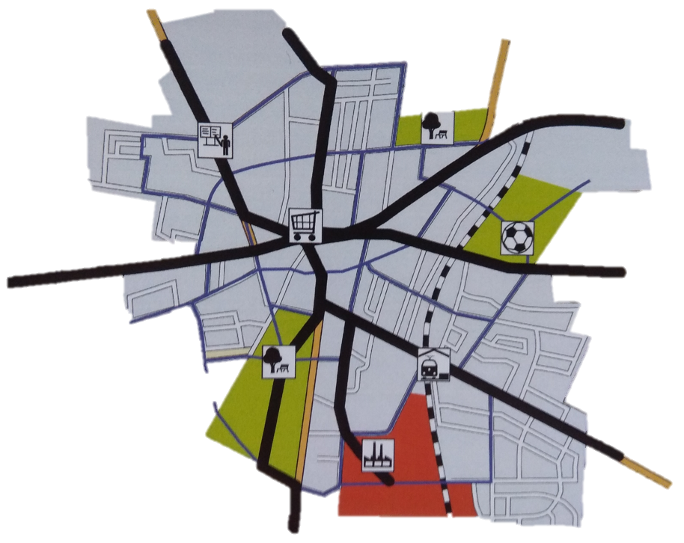
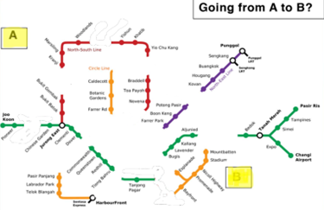
Cycling infrastructure network planning process was missing

Slide 18
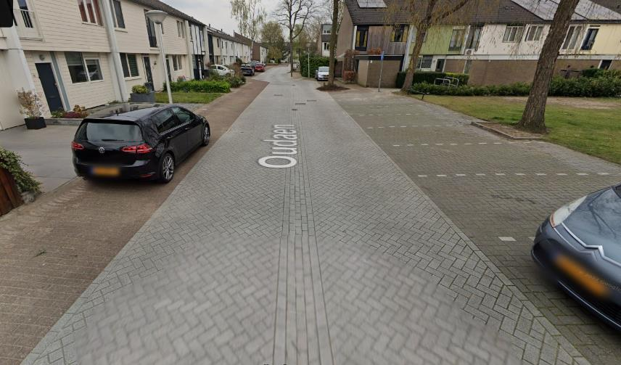
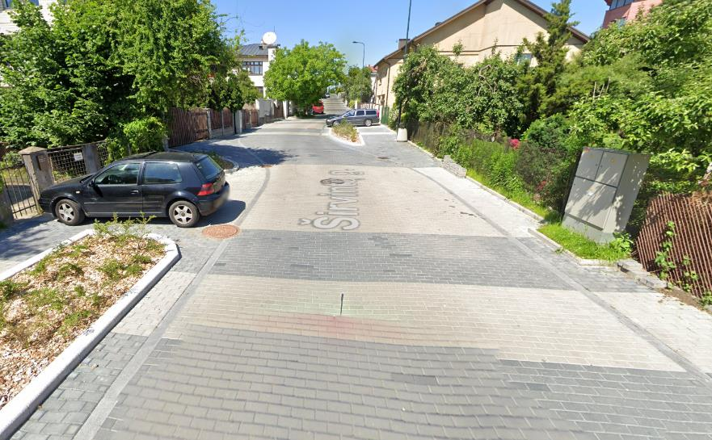
Change – transformation of residental streets into low speed streets

Slide 19
Financial perspectives
... mln. Eur.
Municipality budget
Road Financing Fund (LRA)
EU 2021-2027 (for 18 municipalities with SUMPS)
EU 2021-2027 (for LRA)
X3 times
100 mln. Eur.
25 mln. Eur.

Slide 20
Supervision and monitoring of the use of EU funds:
2.7.1. Only for main, flow funcion routes to connect main destination points in the cities and towns (or suburbs) without gaps;
2.7.3. Possible infrastructure types:
2.7.3.1. Separated cycling paths (or separated cycling paths with pedestrian paths near by);
2.7.3.2. Cycling streets.

Slide 21
Supervision and monitoring of the use of EU funds:

Slide 22
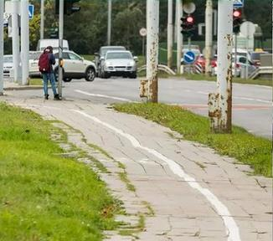
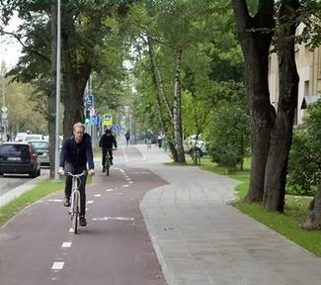
Changes:

Slide 23
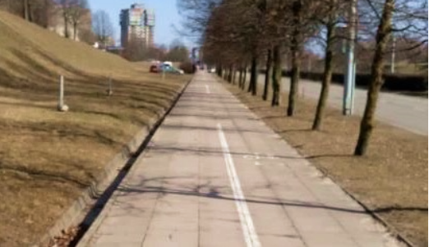
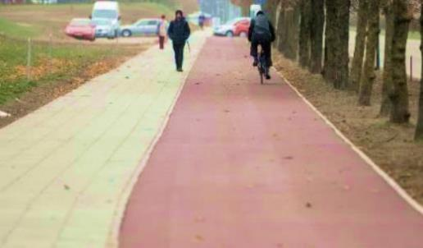
Changes:

Slide 24
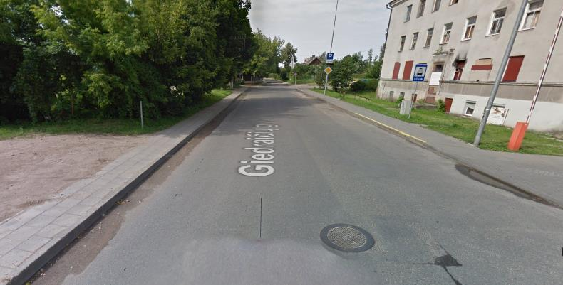
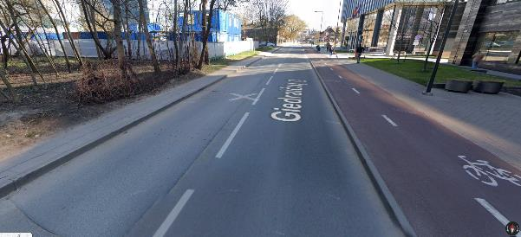
Changes:

Slide 25
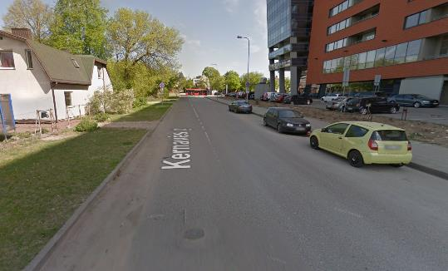
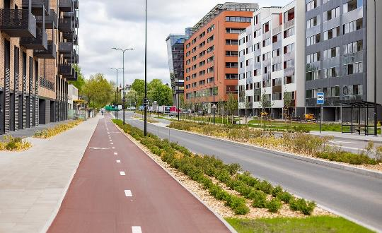
Changes:

Slide 26
Infrastructure development 2021-2023:

Slide 27
Infrastructure development 2021-2023:
There are 12 municipalities with 0 km cycling infrastructure in period 2021-2023

Slide 28
Infrastructure development plan for period 2021-2035 (optimistic):
To implement not less than 2000 km of new bicycle infrastructure to 2035
2022 2023 2024 2025 2026 2027 2028 2029 2030 2031 2032 2033 2034 2035
YEAR
140 140 140 140 140 140 140 140 140 140 140 140 140 140
KM OF INFRASTRUCTURE EVERY YEAR
NOT LESS THAN 600-700 MLN. EUR.

Slide 29
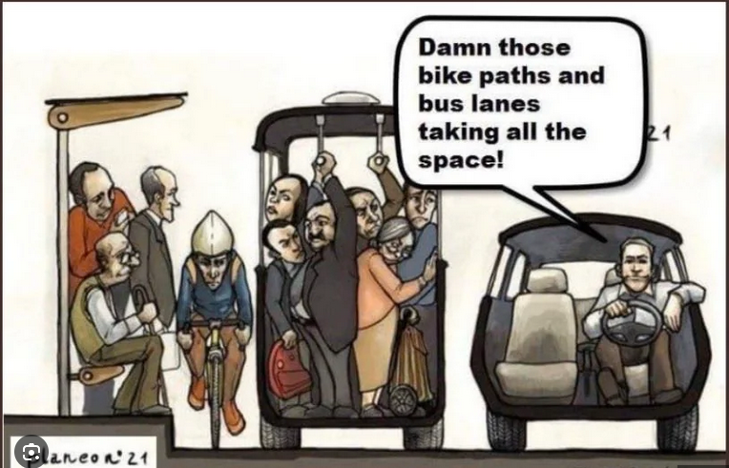
Thank you for your attention!

