Slide 1
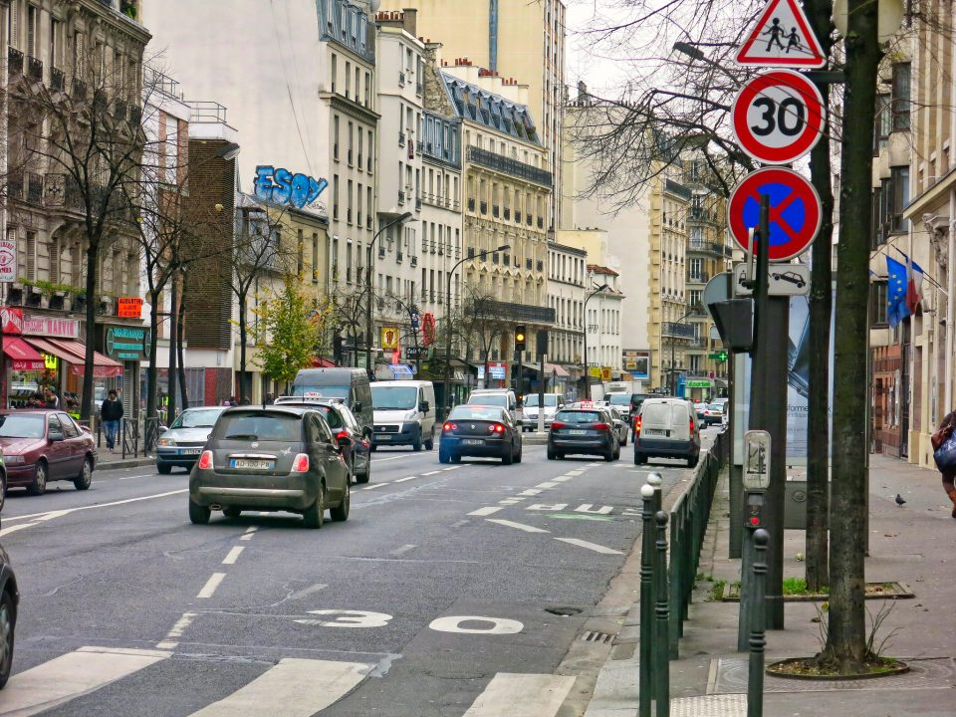
Road Safety Performance Index debate - PIN Talk
Speed and improving the safety of vulnerable road users
Rīga, Latvia, 11 September 2024
Review of 30 km/h speed limit benefits in Europe
Eva Michelaraki
Research Associate
Together with: George Yannis, Professor
Department of Transportation Planning and Engineering
National Technical University of Athens

Slide 2
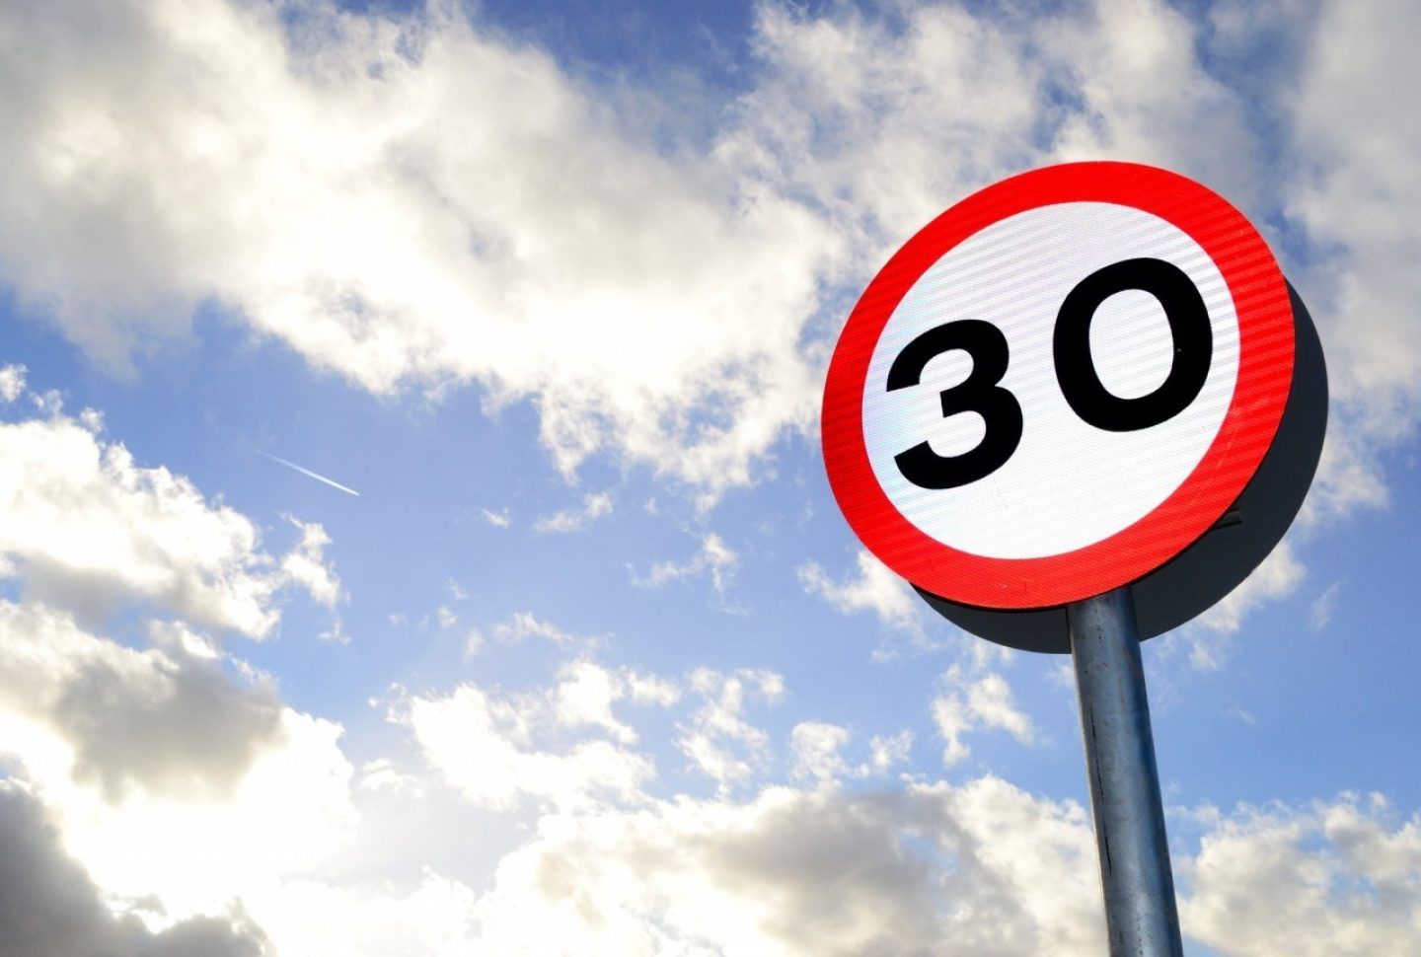
Outline
Key facts about speeding
Scientific evidence on 30km/h city-wide schemes
Cost benefit analysis example
Conclusion
30 Marathons in 30 months campaign

Slide 3
Objectives
Critical assessment of the effectiveness of city-wide 30 km/h speed limit in order to enhance urban sustainability
Identification of changes before and after the implementation of city-wide 30 km/h speed limits in terms of:
Safety
Emissions
Energy
Traffic
Liveability
Health

Slide 4
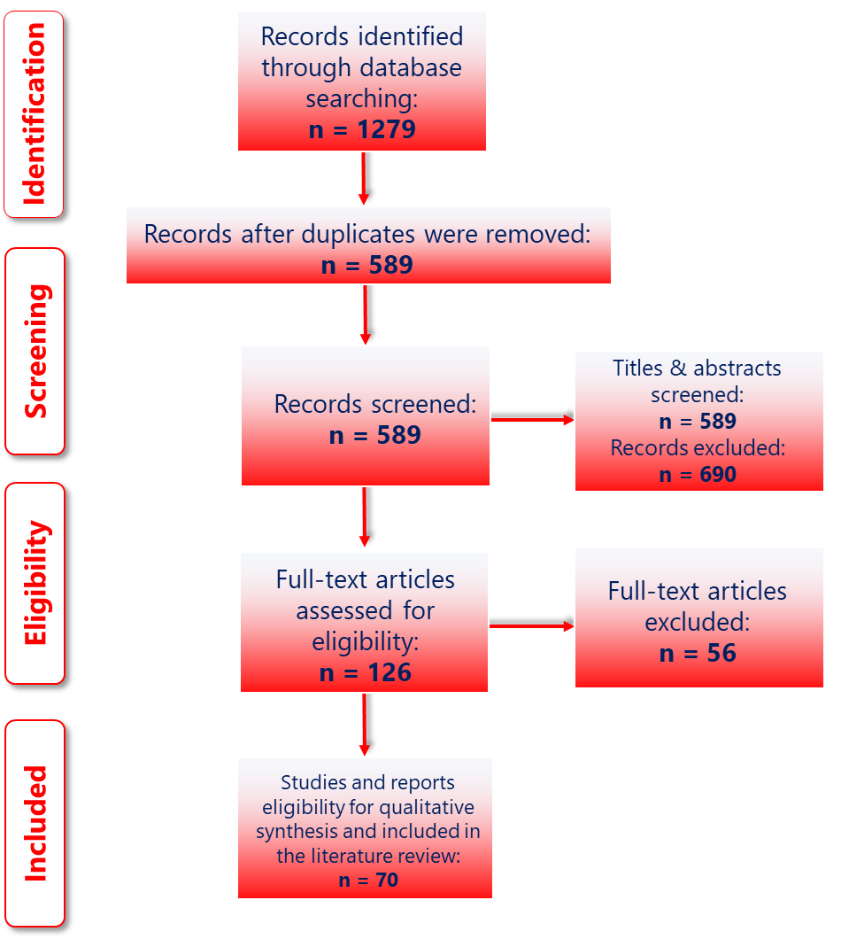
Methodology
Key search phrase | Search terms | Screened papers | Included papers
30 km/h speed limit | "30 km/h" OR "20 mph" OR "30 km/h speed limit" OR "speed limit" OR "speed limit reduction" OR "maximum speed" OR "reduced speed" AND “traffic calming” AND "mobility" AND “city-wide” AND “cities” AND “implementation modalities” AND "benefits" AND "urban areas" | 589 | 70
Meta-analyses from 17 cities and 70 studies were reviewed
Systematic search of relevant scientific and grey literature, according to the Preferred Reporting Items for Systematic reviews and Meta-Analyses (PRISMA)
The inclusion criteria for selecting relevant studies were:
Search term included in title, abstract or key words
Studies published from 1992 and onwards
Studies including information with regards to 30 km/h speed limit in the title or abstract
Source: peer-reviewed journals before peer-reviewed conference papers before scientific papers/articles
The PRISMA flowchart

Slide 5
Key Facts about Speeding

Slide 6
Speeding Kills (1/2)
Road crashes is a major societal problem worldwide, with 1,19 million road fatalities per year and more than 50 million of road injuries
Speeding is the number one cause of road crashes worldwide, especially in cities where pedestrians, cyclists and motorcyclists are highly exposed and vulnerable in case of a collision (70% of fatalities in urban areas are VRUs)
Speed has been found to be a major contributory factor in around 10-15% of total crashes and in around 30% of fatal crashes
Speed effects the quality of life of urban residents, especially the safe mobility of vulnerable road users

Slide 7
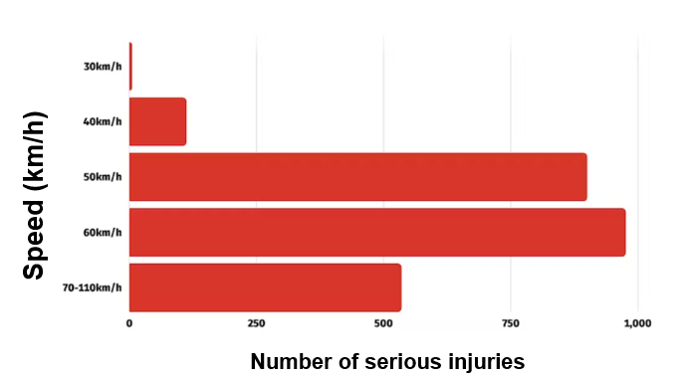
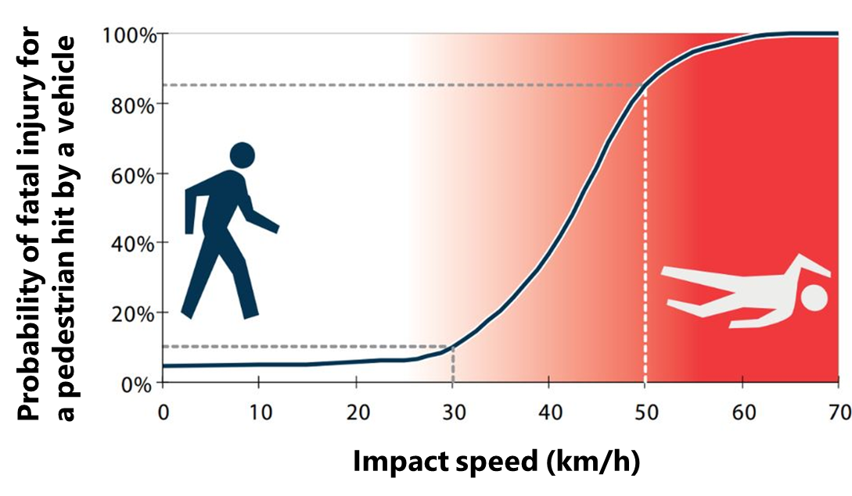
Speeding Kills (2/2)
When speed increases, the risk of a crash and of its severity increases as well
A 5% increase in average speed leads to approximately a 10% increase in all injury crashes and a 20% increase in fatal crashes
The increase in crash risk is usually attributed by the fact that when speed increases, the time to react to traffic situations is shorter and manoeuvrability of a speeding car is limited
Pedestrian fatalities increase from 10% in 30km/h collisions to 90% in 50km/h collisions

Slide 8
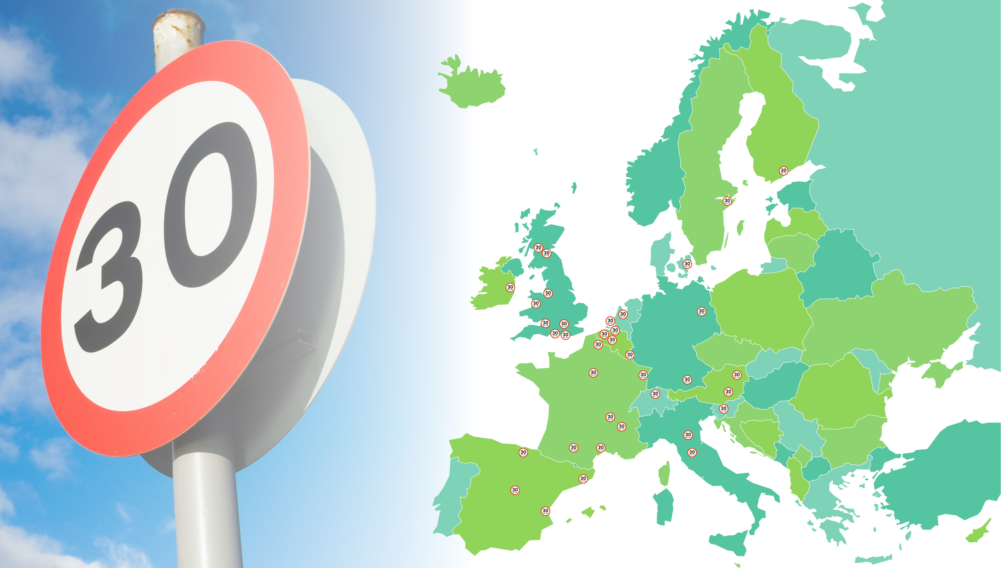
Scientific Evidence on 30km/h City-wide Schemes

Slide 9
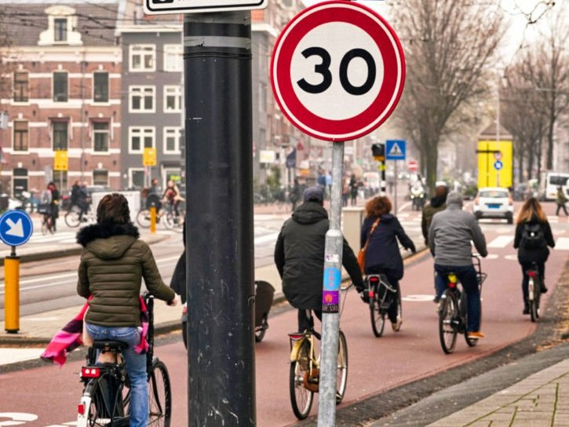
Benefits from 30km/h Speed Limit (1/2)
according to international literature
Setting a speed limit of 30 km/h where people and traffic mix, make streets safer, healthier, greener and more liveable
Road crashes reduction
Reductions in speed limits are intended to improve road safety by decreasing travelling speed and thus reducing the risk of crashes occurring and the severity of crashes that do occur
The risk of death is almost five times higher in collisions between a car and a pedestrian at 50 km/h compared to the same type of collisions at 30 km/h
Air pollution reduction
Streets that promote safe walking and cycling can reduce car dependency and harmful vehicle emissions that contribute to climate change
City-wide 30 km/h speed limit reduce carbon dioxide and nitrous oxide emissions from diesel cars, and particulate matter emission from both diesel and petrol cars, thus reducing air pollution

Slide 10
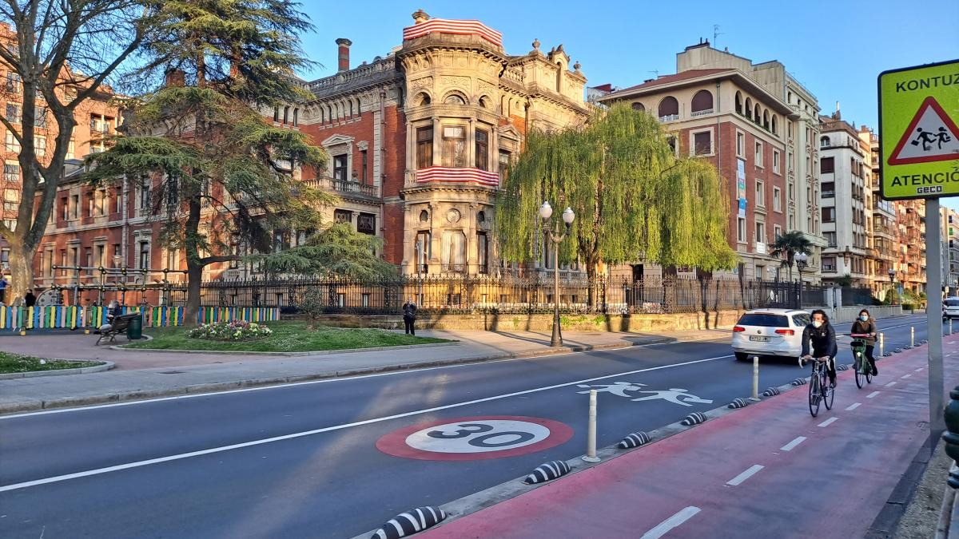
Benefits from 30km/h Speed Limit (2/2)
according to international literature
Fuel consumption reduction
Lower speeds lead to lower fuel consumption
Smoother traffic flow leads to additional fuel economy (eco-driving)
Traffic flow improvement
Motor traffic volumes decrease, since slower speeds encourage active, sustainable and shared travel
Reducing the speed limit at 30km/h improves traffic flow, reduces congestion and improves travel times as there is less stop/start traffic movement
Sustainable improvement
Calm driving in lower speeds is a mean of healthier living for all road users; and especially children and the elderly walk more freely
Significant increase (in the mid-term) of pedestrian, cyclists and e-scooter active mobility and Public Transport passengers

Slide 11
Cities with 30 km/h Speed Limit
A/A | City | Implementation Started |  | A/A | City | Implementation Started
40 | Amsterdam | December 2023 |  | 20 | Lille | August 2019
39 | Wales | September 2023 |  | 19 | Helsinki | May 2019
38 | Bologna | July 2023 |  | 18 | Madrid | September 2018
37 | Florence | November 2022 |  | 17 | Bilbao | June 2018
36 | Copenhagen | June 2022 |  | 16 | Strasbourg | February 2017
35 | Lyon | March 2022 |  | 15 | Dublin | January 2017
34 | Den Haag | December 2021 |  | 14 | Berlin | January 2017
33 | Zurich | December 2021 |  | 13 | Edinburgh | July 2016
32 | Toulouse | November 2021 |  | 12 | London | June 2016
31 | Vienna | September 2021 |  | 11 | Grenoble | January 2016
30 | Paris | August 2021 |  | 10 | Ljubljana | September 2015
29 | Montpellier | August 2021 |  | 9 | Luxembourg | August 2015
28 | Münster | July 2021 |  | 8 | Ghent | April 2015
27 | Valencia | May 2021 |  | 7 | Bristol | 2015
26 | Leuven | April 2021 |  | 6 | Munich | 2011
25 | Brussels | January 2021 |  | 5 | Brighton | 2010
24 | Nantes | August 2020 |  | 4 | Hove | 2010
23 | Glasgow | January 2020 |  | 3 | Warrington | July 2005
22 | Antwerp | January 2020 |  | 2 | Stockholm | 2004
21 | Barcelona | December 2019 |  | 1 | Graz | September 1992

Slide 12
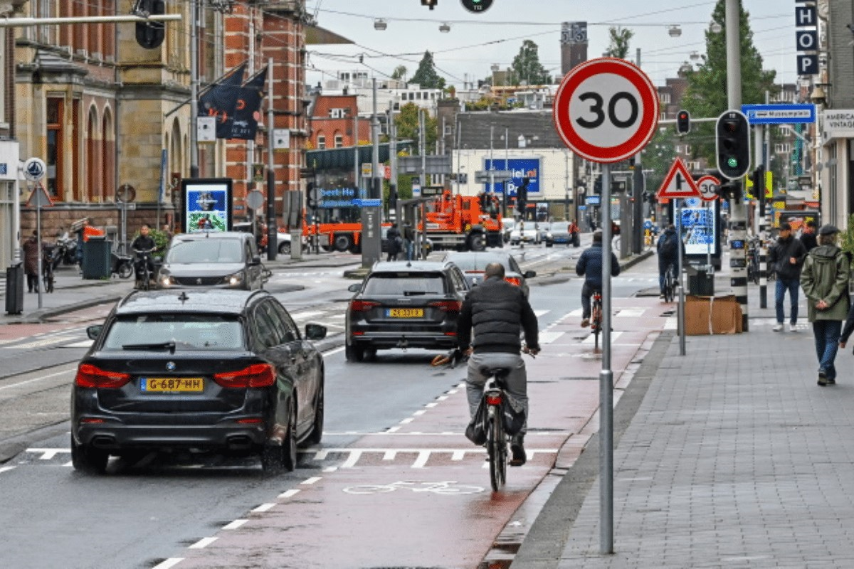
30km/h Speed Limit in Cities (1/2)
Yannis, G., & Michelaraki, E. (2024). Review of City-Wide 30 km/h Speed Limit Benefits in Europe Sustainability, 16(11), 4382
City-wide 30km/h speed limits led to average reduction in:
(meta-analyses from 17 cities and 70 studies)
Fatalities by 37%
Serious injuries by 38%
Road crashes by 23%
Emissions by 18%
Noise by 2.5 db
Fuel consumption by 11%
Traffic congestion by 4%

Slide 13
30km/h Speed Limit in Cities (2/2)
Yannis, G., & Michelaraki, E. (2024). Review of City-Wide 30 km/h Speed Limit Benefits in Europe Sustainability, 16(11), 4382
Fatalities:
63% and 55% reduction in Bristol and Brussels
Serious injuries:
72% and 50% reduction in Münster and Grenoble
Road crashes:
46% and 40% reduction in London and Paris
Emissions:
29% and 25% reduction in Berlin and Graz
Noise:
3 db reduction in Paris and Berlin
Energy:
12% and 10% reduction in Münster and Brussels
Traffic congestion:
9% and 2% reduction in Grenoble and Bilbao
City | Safety |  |  | Emissions |  | Energy | Traffic
 | Crashes | Fatalities | Injuries | CO₂, NO_{x}, PM | Noise | Fuel | Congestion
Bologna | -38% | -33% | -10% | -23% |  |  | -3%
Zurich | -16% | -25% | -20% |  | -1.7 dB
Paris | -40% |  | -25% |  | -3 dB
Münster |  |  | -72% | ↓ | ↓ | -12%
Brussels | -10% | -55% | -37% |  | -2.5 dB | -10%
Glasgow |  | -31%
Helsinki | -9% |  | -42%
Bilbao | -28% |  |  | -19% |  |  | -2%
Berlin | -10% |  |  | -29% | -3 dB
London | -46% | -25% | -25% | -10%
Grenoble | ↓ | ↓ | -50% |  |  |  | -9%
Edinburgh | -38% | -23% | -33% | -8% |  |  | -2.4%
Bristol |  | -63%
Brighton |  |  | -45%
Hove |  |  | -45%
Warrington |  |  | -43%
Graz | -12% |  | -20% | -25% | -2.5 dB
* grey colour indicates that the impact of the implementation of 30 km/h in this city has not been examined yet
** the symbol ↓ indicates that the quantitative effect of this measure has not been provided; only qualitative impact is given
*** these reductions refer to a comparison period before and after the implementation of 30 km/h speed limits which is not the same among all cities examined

Slide 14
Cost Benefit Analysis Example

Slide 15
Cost Benefit Analysis Results – Athens (1/2)
Policy Speed Limit 30km/h
ENPV >0,
aprox. 35 (mil. €)
ERR > SDR: ERR=64.5%>SDR=0.8%
Timeframe 2021-2030
B/C >1, B/C=1,55
A Cost Benefit Analysis for the City of Athens was implemented till the year 2030, by including all the Costs (Implementation and Operational) and all the Benefits (Road Crashes, Fuel Consumption, Emissions) which concludes to the following results:
In the case of the reduction of the speed limit to 30 km/h in the city center, the society benefits from a reduction in road casualties amount to €130 million over a 10-year period
All the examined policies present a positive ENPV and an ERR higher than the Social Discount Rate (0.8%), indicating their feasibility over time
The most important economic benefit arises due to the improvement of road safety through the reduction of fatalities on road crashes

Slide 16
Cost Benefit Analysis Results – Athens (2/2)
It is estimated that city-wide 30 km/h speed limits on the road network of City of Athens (with the exception of major axes) will save lives annually:
33 fatalities,
83 seriously injured and 830 slightly injured
fuel consumption by 48 million litres
65.5 thousand tonnes of CO₂, ΝΟ_{Χ} και PM
The traffic congestion change is negligible
The indirect benefits of increasing the use of Public Transport and active travel are also significant

Slide 17
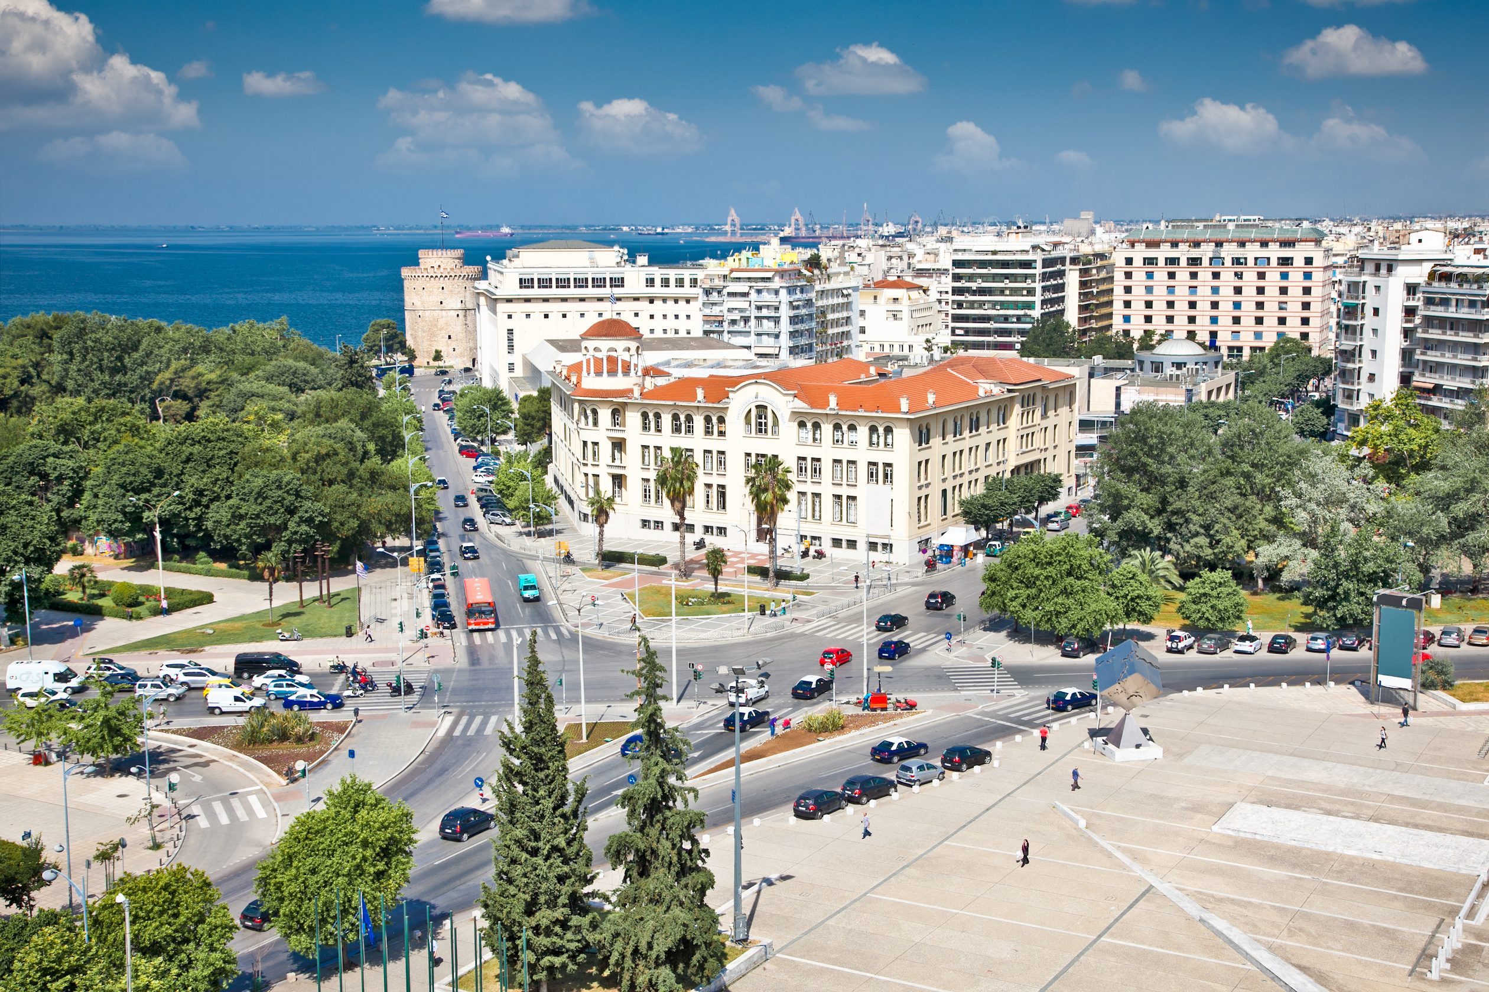
Cost Benefit Analysis Results – Greece
It is estimated that city-wide 30 km/h speed limits on the road network of all cities in Greece (with the exception of major axes) will save lives annually:
104 fatalities (out of 635 in all of Greece)
123 seriously injured (out of 636 in all of Greece)
783 slightly injured (out of 12,533 in all of Greece)

Slide 18
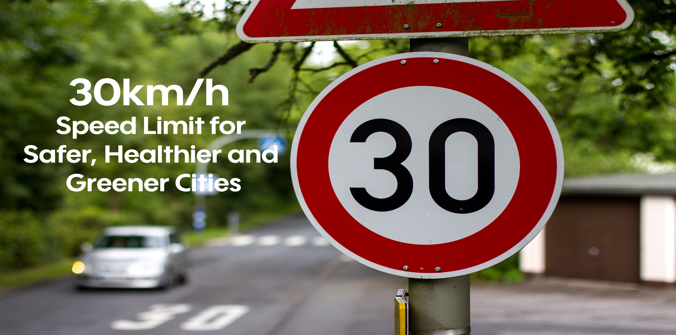
Conclusion

Slide 19
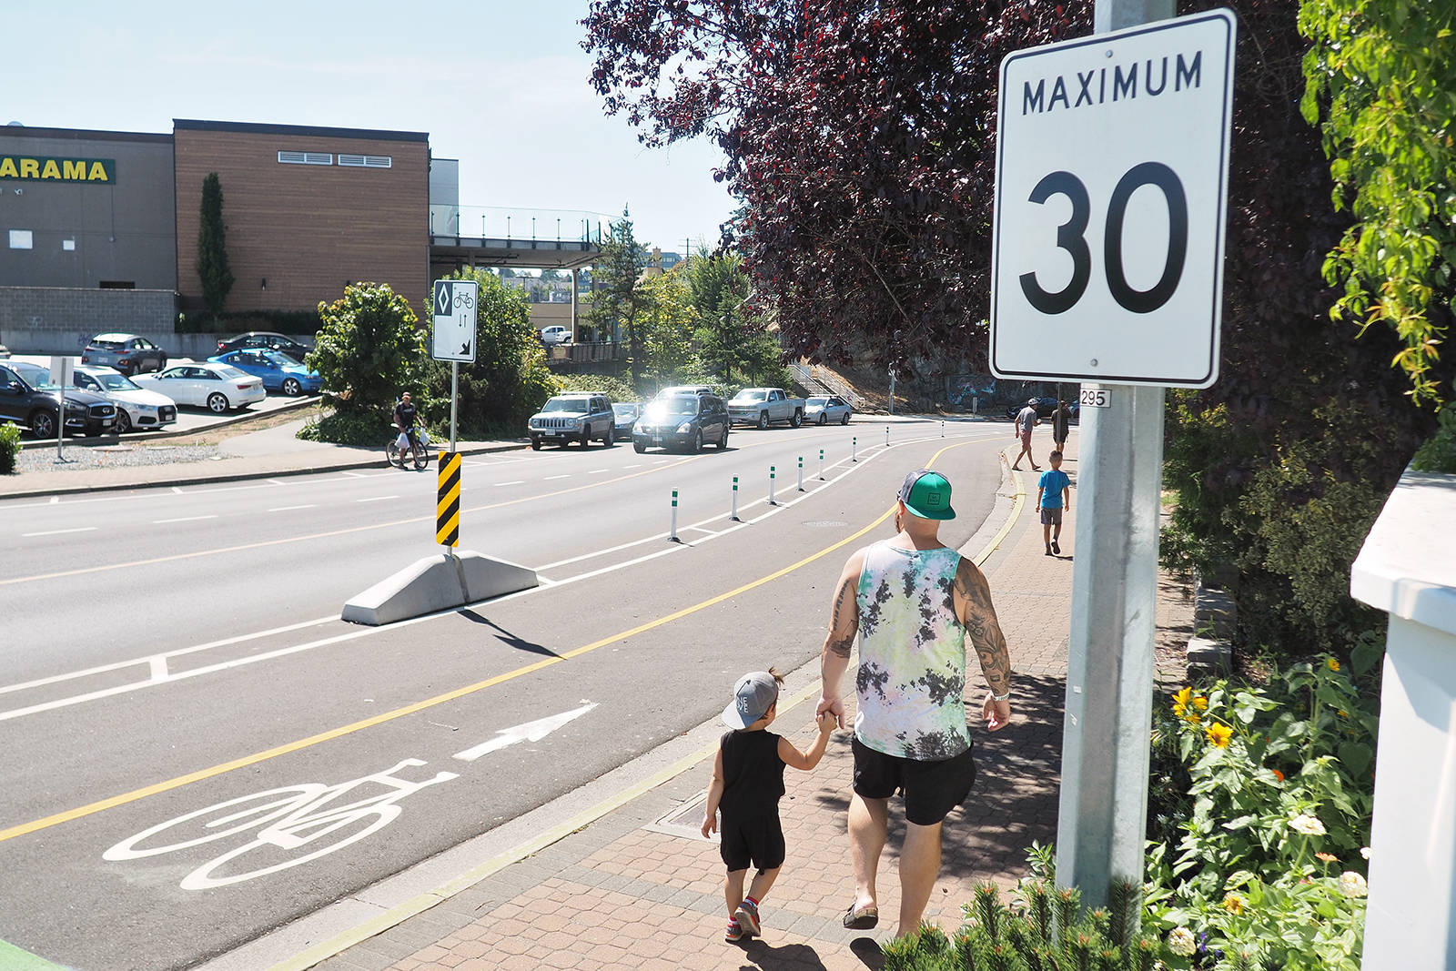
Conclusion
More livable cities
Speed limits reduction gaining rapid acceptance across Europe and more and more European cities adopting lower speed limits
Significant socio-economic impact
The reduction of speed limits in cities (30km/h) leads to a significant reduction in:
- fuel/energy consumption and air pollution
- road crashes and congestion
without a significant decrease in travel times
Increase of acceptance
Public acceptance of speed limits reduction tends to improve over time, especially by pedestrians, cyclists and Public Transport passengers
Inertia and reactions from car drivers need to be addressed

Slide 20
The road safety catalyser
The implementation
of city-wide 30km/h speed limit
is the since-long waited,
single road safety measure
with such a significant improvement
at such a low cost
Such a high societal impact
for such a small change in our habits

Slide 21
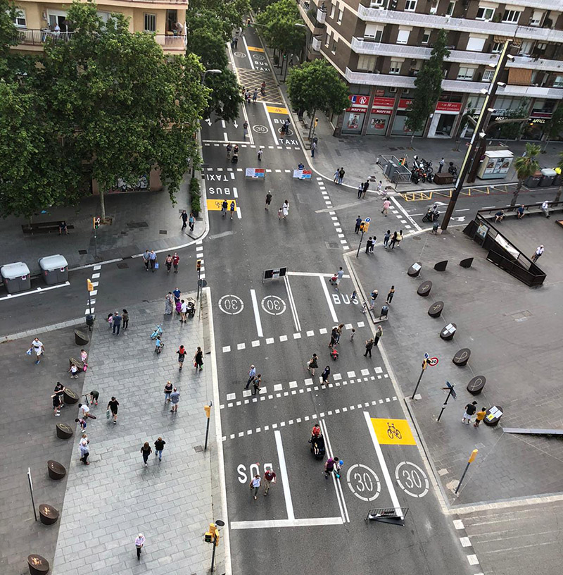
Accompanying Measures
Public consultation and awareness campaigns
Public transport and active mobility promotion
Traffic calming measures
Intelligent transportation systems
Monitoring and evaluation
Enforcement and police cooperation

Slide 22
30 Marathons Campaign
Despite the blatant scientific evidence, the discussion and introduction of city-wide 30 km/h speed limit faces strong reactions and rigid inertia, whereas supporters' voices are often weak and inefficient resulting in hesitant politicians and Authorities
After more than 30 years of dedication to road safety science and several Marathon races, Prof. George Yannis decided to step beyond the traditional scientific pleas and combine both passions for a cause: to run 30 Marathons in 30 months to actively promote the adoption of city-wide 30km/h speed limit in as many cities as possible worldwide

Slide 24
Road Safety Performance Index debate - PIN Talk
Speed and improving the safety of vulnerable road users
Rīga, Latvia, 11 September 2024
Review of 30 km/h speed limit benefits in Europe
Eva Michelaraki
Research Associate
Together with: George Yannis, Professor
Department of Transportation Planning and Engineering
National Technical University of Athens

