Slide 1


EUROPEAN COMMISSION
Directorate-General for Structural Reform Support
Funded by
the European Union
Improving Road Safety for Vulnerable Road Users in Latvia
PIN Talk
September 11th, 2024

Slide 2
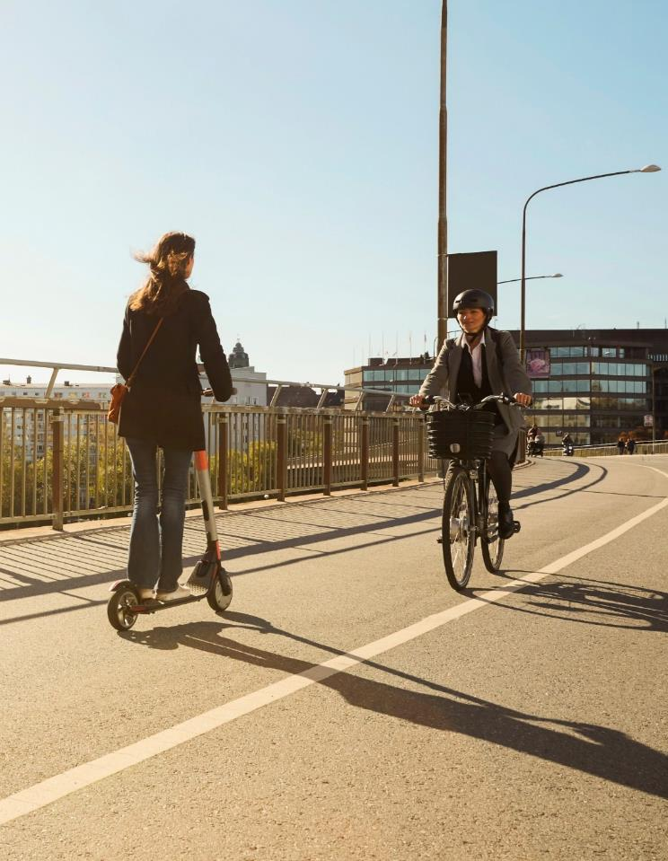
INSTRUCTIONS:
How to hyperlink slide titles in the Agenda section to the respective slides
> Select the title of the respective slide you want to hyperlink, located here under the yellow number
> With the title selected, go to the Insert tab and click on “Action”.
> In the new pop-up window, select “Hyperlink to”, and in the dropdown click on “Slide”
> On the left side of the new window you can choose which slide the text should hyperlink to. When you are done, click on “Ok”.
The role of micromobility
1
Objectives and activities of the Project
Agenda
2
Key takeaways
3
Recommendations – highest priorities

Slide 3





The role of micromobility
Increasing role of the micromobility
Micromobility is reshaping urban transport, offering benefits while posing challenges for vulnerable road users
  Reduces Congestion
  Supports green urban living
  Provides affordable transportation options
How to recognize a vulnerable road user?
Motorized road users
Non-motorized road users
Challenges to vulnerable road users
Increased accidents involving pedestrians and cyclists
Lack of dedicated lanes and parking areas
Need for clear rules on usage and integration with traffic
Informing users about safe and responsible riding
Motorcyclists
Quadra cyclists
Tricyclists
Electric scooter riders
Pedestrians
Cyclists
Others
Our priorities in the future
Thoughtful infrastructure and regulation development, and community engagement
The future of urban mobility hinges on the successful cooperation of policy makers and integration of micromobility solutions into urban ecosystem
People with disabilities or reduced mobility and orientation

Slide 4

1
Objectives and activities of the Project

Slide 5
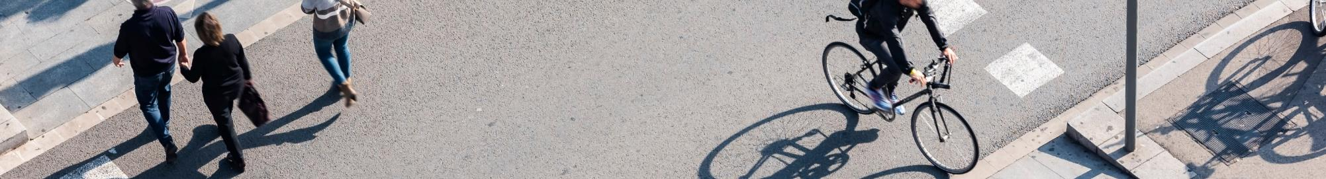
Objectives of the Project
The general objective: to support institutional, administrative, and growth-oriented structural reforms in Latvia
The specific objective: to aid national authorities in decreasing the occurrence of traffic accidents resulting in serious injury or fatality among vulnerable road users (VRUs)
Deliverable
“Mirroring” your structure and operating model
AS-IS report and gaps analysis on road safety situation for vulnerable users
Report with recommendations for improving road safety for VRUs and a roadmap for its implementation
Report on awareness raising campaign
Tasks
Kick-off meeting
Preparation of inception report
Preparation of Project description summary
Analysis of best practices
Analysis od the as-is situation and gap analysis
Data analysis
Recommendation development for improving road safety for vulnerable road users
Development of an implementation roadmap
Development of methodology and plan of awareness raising campaign
Strategy and creative development
Organizing a multimedia awareness raising campaign

Slide 6
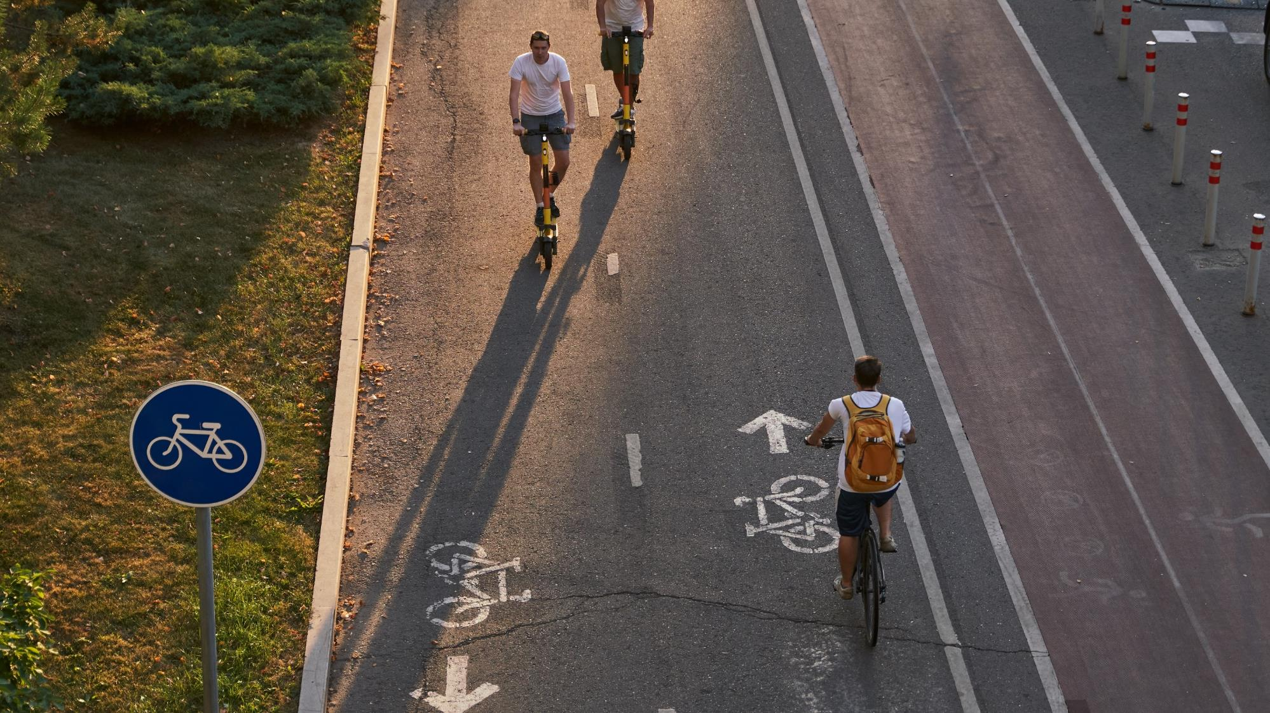
Stakeholders of the Project
Neighborhood associations
Emergency medical services (NMPD)
NGO “Pilsēta cilvēkiem”
Ministry of Transport
Crisis and counseling center «Skalbes»
Road Traffic Safety Directorate (CSDD)
Project stakeholders
Latvian State Roads (LVC)
NGO “Drošās ielas”
State Police
Social Integration State Agency
Association of Cyclists of Latvia
Micromobility service providers

Slide 7






Safety dimensions
Road safety dimensions that form the basis of road safety development and implementation according to road safety frameworks¹
Safe roads
Safe post-crash care
Safe speeds
Road traffic safety
Safe road users
Safe vehicle
¹ European Commission, the World Bank, the United Nations, and the European Union

Slide 8


Data analysis methodology
Analysis of road traffic accident data and data of micromobility service providers: in-depth investigation of accidents
Statistical analysis of road accidents
A comprehensive analysis of annual traffic accident data
Correlation of traffic accidents and micromobility traffic intensity
The goal is to understand the types and causes of accidents, types of vehicles, as well as the place of accidents and other conditions such as intoxication, weather.
Assessment of road traffic accident conditions – user behavior, street lighting, road design, road condition, time of day, etc.
Conclusions on existing road traffic safety deficiencies

Slide 9
2
Key takeaways

Slide 10




AS-IS situation in Latvia
Safe roads
Unified network | Infrastructure in Latvia is fragmented VRUs that are not pedestrians are moving around the street a lot
Infrastructure design | Infrastructure in Latvia often is not in line with the purpose of the road Lack of standardized design (e.g., coloring of cycling paths)
Pedestrian crossings | Raised pedestrian crossings are not observed often
Safe speed
30 km/h zones | Municipalities in Latvia have been slow to introduce 30 km/h zones
Fines for speeding | For speeding 1-10 km/h over the speed limit only a warning applies
Safe user behaviour
Unsubstantiated emphasis on VRUs | Significant emphasis on the responsibility of VRUs, while comparatively less emphasis is placed on heavy motorized vehicle users Less clarity about the use of space for VRUs
Driving under the influence | The legal alcohol limit for driving is higher at 0.5 BAC Micromobility users have perception of impunity for driving intoxicated Data analysis shows high level of intoxicated accidents involving scooter/bike

Slide 11
AS-IS data analysis concerning VRUs
Type of road accidents involving VRU in 2023
Data analysis of vulnerable road user accidents¹
2 408 road accidents in 2023 involving vulnerable road users
“Hitting a pedestrian” accounts for 776 accidents (38.3%) of total accidents
  highest number of fatalities at 30, making up 54.5% of the total deaths
“Collision” accounts for 561 accidents (28.2%) of total accidents
  11 fatalities which amounts to 20% of all deaths
“Hitting a cyclist” accounts for 405 accidents (20.2%) of total accidents
¹ data provided by Road Traffic Safety Directorate (2023), with a focus on vulnerable road users (including pedestrians, cyclists, electric scooters, mopeds, etc.)

Slide 12
3
Highest priorities

Slide 13


Recommendations
Safe roads (infrastructure)
Guidelines for creating safer infrastructure in the urban environment
Emphasize piloting new infrastructure solutions within development projects
Policy development for mandatory traffic education within national educational curricula.
Promote and encourage schools to participate in existing educational projects "Learn and get a bicycle license in your school"
Safe user behavior (education)
Implement a zero-tolerance policy for driving under the influence of alcohol
Remove the 10 km/h tolerance above speed limits before penalties are applied
Introduce alcohol interlocks as a standard drink-driving monitoring measure
Increase the penalties for traffic violations for all vehicle users
Explore the feasibility of equipping police vehicles with 360-degree cameras
Implement red light cameras at intersections
Require micromobility service providers to implement reaction tests for all rentals on Friday and Saturday evenings and nights (23:00-06:00)
Safe user behavior (enforcement, fines)
Safe post-crash care
Develop a unified mechanism for collaboration among stakeholders involved in road safety efforts

Slide 14
EY | Building a better working world
EY exists to build a better working world, helping to create long-term value for clients, people and society and build trust in the capital markets.
Enabled by data and technology, diverse EY teams in over 150 countries provide trust through assurance and help clients grow, transform and operate.
Working across assurance, consulting, law, strategy, tax and transactions, EY teams ask better questions to find new answers for the complex issues facing our world today.
EY refers to the global organization, and may refer to one or more, of the member firms of Ernst & Young Global Limited, each of which is a separate legal entity. Ernst & Young Global Limited, a UK company limited by guarantee, does not provide services to clients. Information about how EY collects and uses personal data and a description of the rights individuals have under data protection legislation are available via ey.com/privacy. For more information about our organization, please visit ey.com.
© 2023 Ernst & Young Baltic SIA.
All Rights Reserved.
EY – a member of Ernst & Young Global – is a market leading provider of the professional services in the Baltic States. More than 700 EY professionals in the Baltic States offer assurance, consulting, legal, outsourcing, strategy, tax and transactions services.
ey.com

