Slide 1
Speed and vulnerable road users
PIN Talk, Riga | 11 September 2024
Jenny Carson
Project Manager

Slide 2
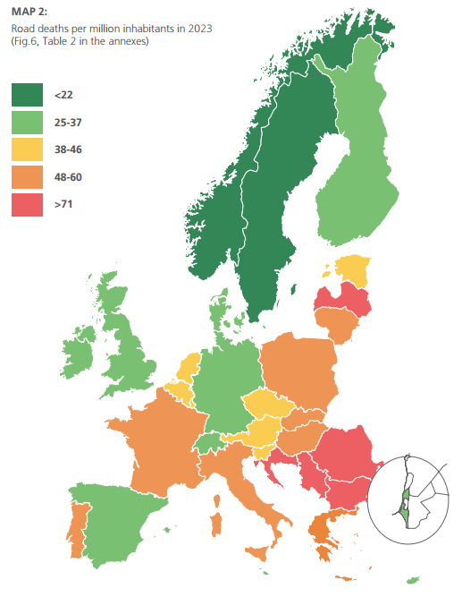
ETSC PIN PROGRAMME
Experts from the 32 participating countries, including all EU Member States
Steering Group
Annual report
PIN Flash reports (46 so far)
PIN Talks

Slide 3
20,418
people died in road traffic in the EU in 2023
Notes:
20,418 people lost their lives in road traffic in the EU in 2023
In the last decade, there were 20,981 fewer deaths than if the death rate had remained at the 2013 level

Slide 4
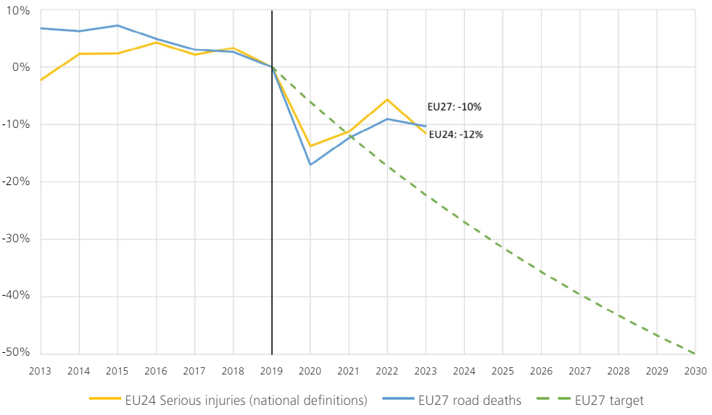
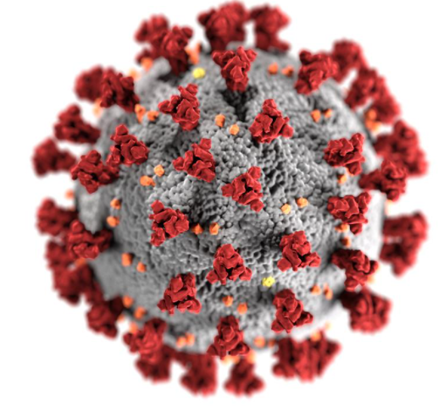
ROAD SAFETY PROGRESS 2013-2023
Notes:
The EU27 collectively reduced the number of road deaths by 16% over the period 2013-2023
There were 20,981 fewer deaths on EU roads over the last decade than there would have been if deaths had continued at the same level as in 2013
Over a six-year period, the reduction in road deaths on EU roads remained stagnant, with only a 6% decrease from 2014 to 2019.
In 2020 there was an exceptional drop of 17% compared to 2019.
2021 also saw a consistent drop of 13% with respect to 2019, but the number of road deaths increased by 5% with respect to 2020.
2022 saw a decrease of 9% with respect to 2019 but the number of road deaths increased by 4% with respect to 2021.
Unfortunately, in 2023, road deaths only decreased by 1% compared to 2022.
The progress in reducing serious road traffic injuries over the last decade in the EU24 collectively was poor, especially in comparison with the reduction in road deaths. There has only been a 10% reduction over the period 2013-2023 (reduction should have been of 22% in order to reach the 2030 target).

Slide 5
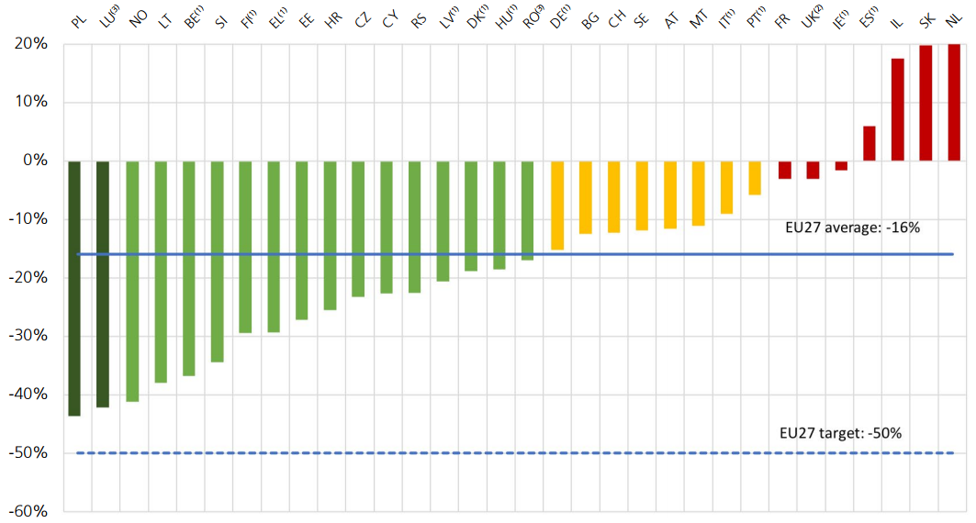
PROGRESS 2013-2023
PL: -44%
LU: -42%
NL: 20%
SK: 20%
Notes:
In the last decade the number of road deaths across EU decreased by 16%. No country managed to halve the number of road deaths over the decade. In four countries the number of road deaths increased.

Slide 6
66% VRUs
1635
Pedestrians killed by car
1127
Single vehicle collisions
Notes:
7665 people killed in urban areas in the EU in 2021.
Nearly 70% of these are vulnerable road users – pedestrians, cyclists and motorcyclists (actual % is 66)
In urban areas pedestrians tend to be killed in a collision with a car
Car occupants tend to be killed in a collision with no other vehicle involved.

Slide 7
Safe speed limits
In 26 out of 27 EU member states the standard speed limit on urban roads at all times is 50km/h
50
According to the Safe System, on urban roads where vulnerable road users mix with motorised traffic, the speed limit should be 30km/h
30

Slide 8
35% and 75%
of vehicle speeds in urban areas are higher than the speed limit
Notes:
On roads with a 50km/h limit
Among the countries that monitor levels of speed compliance on urban roads countrywide, between 35% and 75% of vehicle speed observations are higher than the legal speed

Slide 9
Speed
2019
Notes:
Add that EU KPI is now ‘within the speed limit’
Speed management requires a holistic approach including speeding enforcement, vehicle safety (Intelligent Speed Assistance (ISA)) and infrastructure measures

Slide 10
Speed management
Safe and credible speed limits
Traffic calming, self-explaining/enforcing infrastructure
Enforcement and Campaigns
Vehicle technologies
Notes:
No silver bullet when it comes to managing speed. Instead a combination of measures

Slide 11
Setting safe speed limits
30km/h – urban roads
70 km/h - safe speed limit on rural roads without a median barrier
100 km/h – safe speed on rural roads with median and side barriers
Speed limits of much of the road network in EU countries are higher than the protective quality of the road, roadside and vehicle designs allows
Notes:
Safe System approach has been endorsed in the EU strategic plan of road safety for the upcoming decade.
Safe System and vision zero is also adopted by a number of MS.
Based on Safe System, safe speed limits on rural roads without a median barrier should not be higher than 70 km/h and no higher than 100 km/h on roads with median and side barriers.
In this context safe speed is such that 90% of the collisions that would occur at those recommended speeds would not result in a serious injury.
Current speed limits of much of the road network in EU countries are higher than the protective quality of the road, roadside and vehicle designs allows.

Slide 12
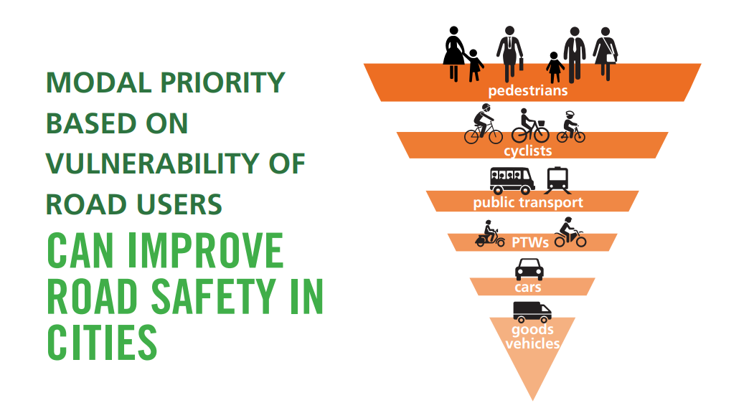
Modal priority
Notes:
Adopt and promote a policy of modal priority for road users, the hierarchy being based on safety, vulnerability and sustainability. Walking should be at the top of the hierarchy, followed by cycling and use of public transport.

Slide 13
Notes:
Many more in our report
Discuss some of them during the debate

Slide 14
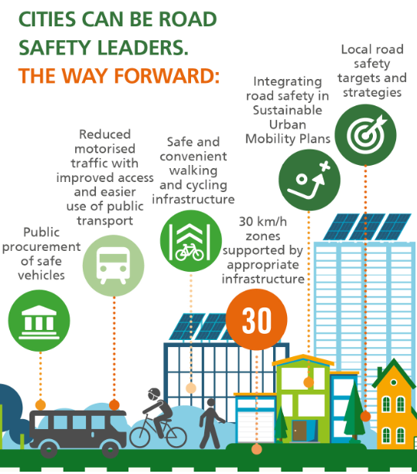
9,500
People killed each year on urban roads in the EU

Slide 15
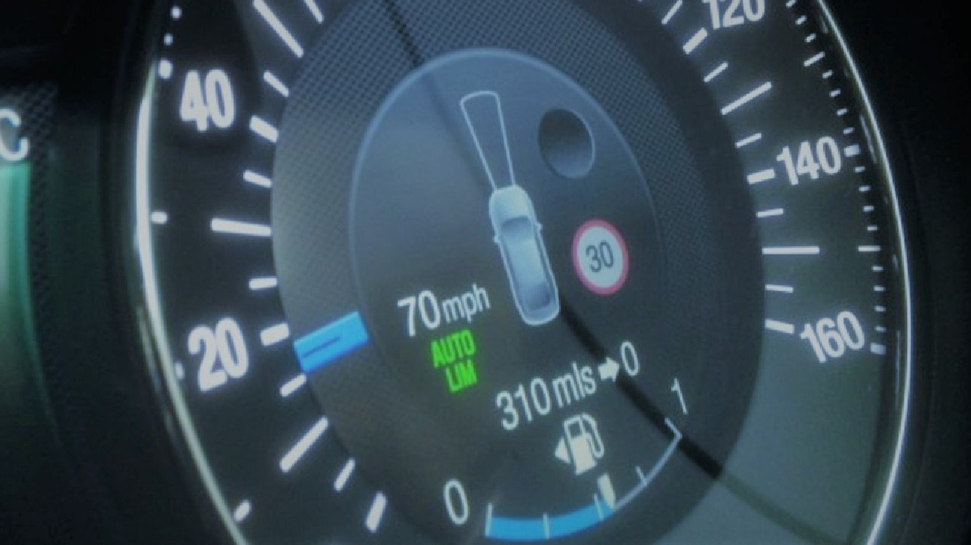
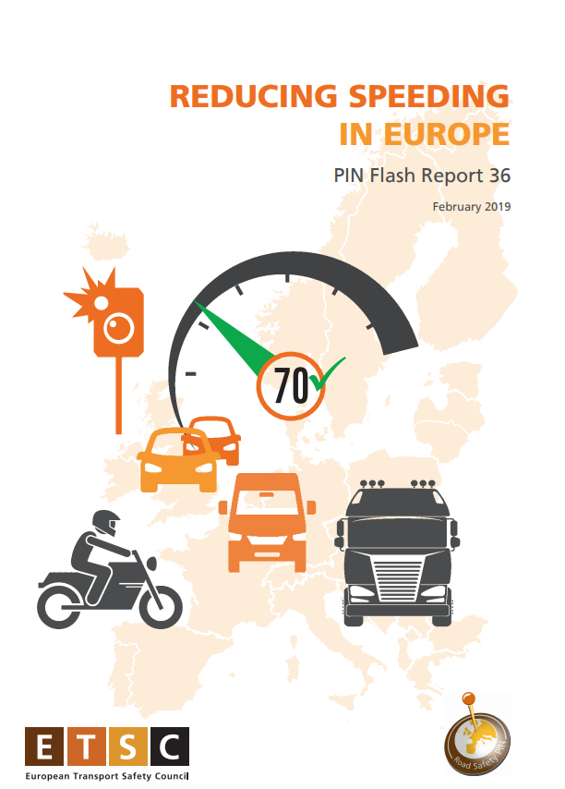
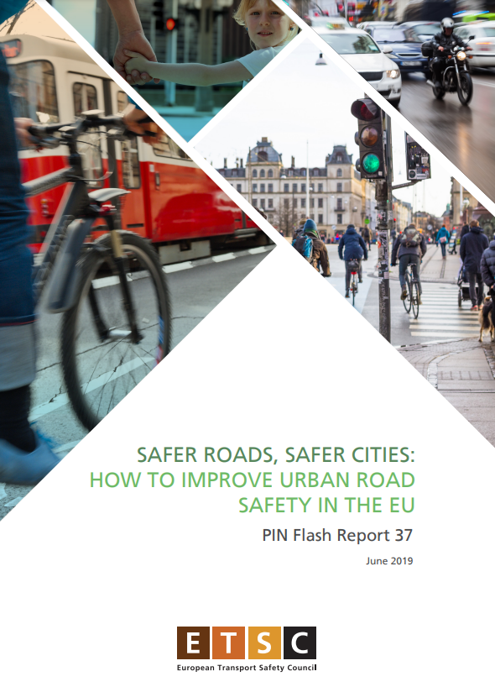
THANK YOU!
www.etsc.eu/pin
@etsc_eu
Jenny Carson
jenny.carson@etsc.eu
Notes:
Please feel free to download the report from the link here.

