Slide 1
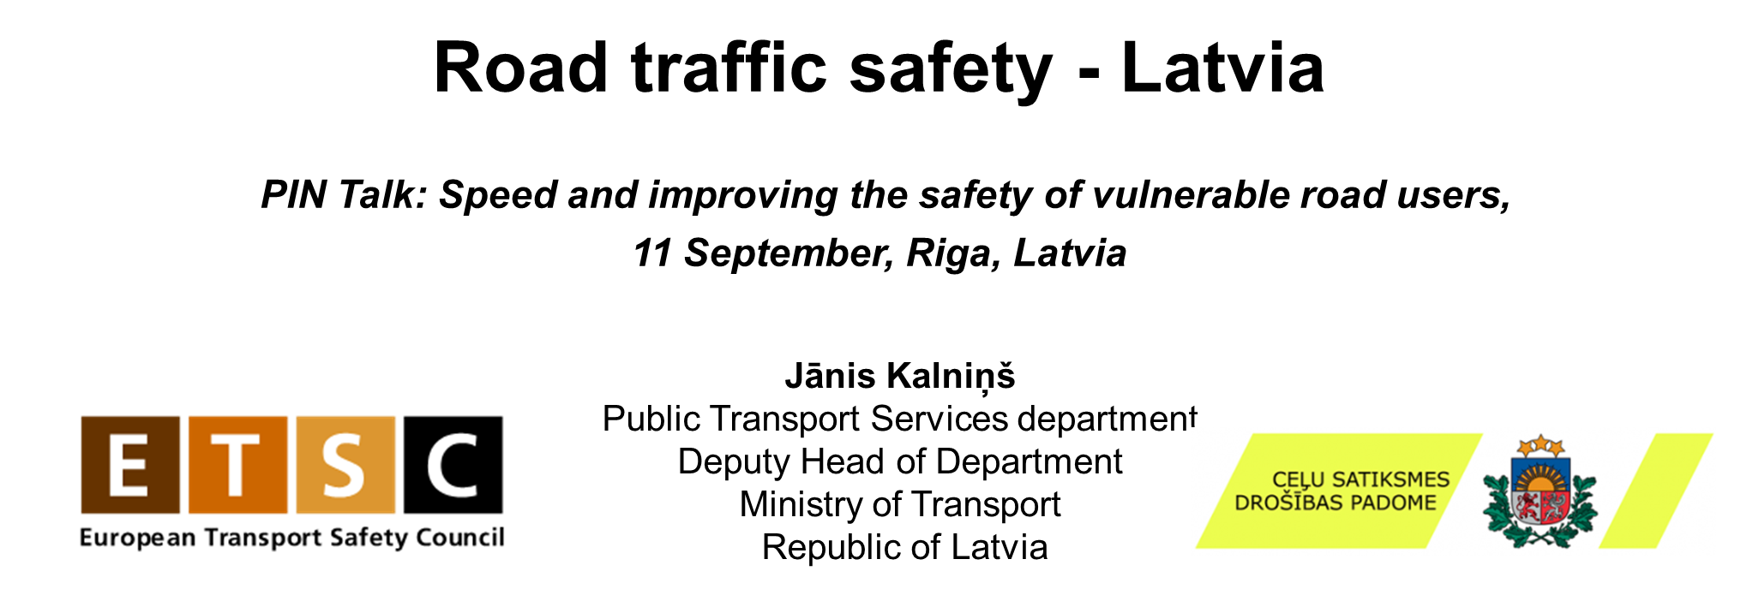
Notes:
Road trafic safety in Latvia
Advancing Road Safety in Latvia: Strategic Initiatives for Reducing Accidents and Enhancing Public Safety
In recent years, Latvia has consistently ranked among the top five EU countries with the highest road fatality rates per million inhabitants, recording 76 fatalities in 2023. Despite ongoing efforts, there has been no decrease in traffic accident-related deaths and serious injuries. This trend is also concerning for vulnerable road users (VRUs), whose rates of severe injuries and fatalities remain notably high without any WZ2S2apparent improvement.
Although the Road Safety Council supports various activities every year—campaigns, studies, individual infrastructure projects, and the purchase of technical and control devices (with an average funding of around 2 million EUR per year)—these measures often have only specific, targeted, and short-term impacts. Measures such as road reconstruction, including in some cases the most expensive solution of separating opposite lanes, cannot be financed from these funding sources. Nevertheless, several projects have been successfully implemented with the Council's funding, such as the introduction of average speed cameras, targeted campaigns (e.g., about driving under the influence), and several studies (e.g., the impact of speed on road safety).
It should also be understood that the existing road network, although regularly improved, does not always meet the safety requirements applicable to modern traffic intensity. Therefore, the partial transfer of domestic cargo from roads to railways should be evaluated. This need is evidenced by recent traffic accident statistics, which include several incidents involving trucks, including head-on collisions and rollovers where only trucks were involved.
A particularly characteristic problem in Latvia is the decision made ten years ago to cancel the monetary penalty in favor of a warning for exceeding the speed limit by up to 10 km/h. This has led some drivers to disregard minor speeding violations. Unfortunately, both research and road measurements indicate that most of the traffic exceeds the permitted speed by up to 10 km/h. This behavior negatively impacts road safety.
The Ministry of Transport has pushed several times in recent years to cancel the warning and impose fines for such transgressions. However, this is an unpopular decision and difficult to gain support for in the coalition. Nonetheless, the Ministry continues to promote this initiative as an important short-term measure.
Although speed is not the only or main factor in traffic accidents, it always exacerbates the severity of the consequences. Research from Riga Technical University supports the internationally proven hypotheses about the impact of speed on accidents and their outcomes. We hope that these arguments will help gain coalition support for this proposal.
At the same time, we are aware that other activities are necessary, including infrastructure improvements. This is a long-term project and cannot be completed in just a few years. Plans include converting certain road sections to separated carriageways. For example, last year, the first private-public partnership project was implemented, creating the Ķekava bypass road as a high-speed highway.
In the short term, we face the same challenges as other EU countries: a shortage of new drivers, a high number of older drivers in the road transport industry, police capacity issues, drunk driving, challenges related to new micromobility tools, aging vehicle fleets, and other similar issues.
We believe it is important and beneficial to exchange experiences, as we often face similar issues. Therefore, we follow trends in other countries and this year, Latvia has joined the OECD ITF IRTAD family, a group of road safety experts and implementers.

Slide 2


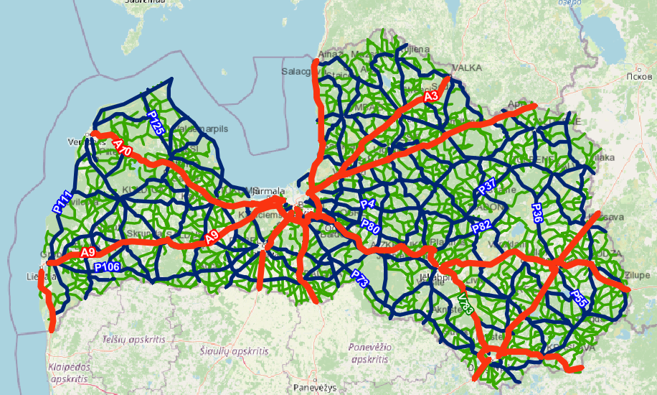

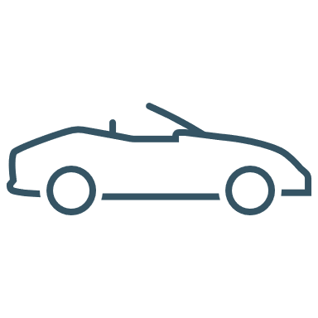



Latvia – few facts
Total area: 64 589 km²
Population : 1 871 882
Roads and streets: 71 157 km
Road density: 1,102 km per km²
Driving licences: 886 863
Vehicle fleet: 943 188 (roadworthy)
Passenger cars: 723 662
Trucks: 92 597
Buses: 3515
Motorcycles: 35 782
Mopeds: 39 037
(2024)
Source: csp.gov.lv, LVC and CSDD
Notes:
.There are a little less than 2 million of us in Latvia, but our car fleet is under one million. There are about 700 thousand passenger cars, 90 trucks and 3.5 thousand buses. the average age of the car fleet is approaching 15 years, but it should also be appreciated that this is a recent trend in all countries - as you know, the car industry is currently in a transitional stage. I am an optimist and hope that the internal combustion car is history, but the electric car is the present, the future belongs to the hydrogen car. But that's not the story for today.
As of 31 December 2023, the total length of listed roads and streets in Latvia is 71 157 km. The average density of the road network is 1,102 km per 1 km2.
main roads connecting the national road network with the main road network of other countries and the capital city with other cities of the Republic or bypass roads of cities of the Republic;
on regional roads connecting the administrative centres of districts with each other or with the cities of the Republic or with the capital, or with the main or regional roads or with each other;
local roads connecting the administrative centres of a county with the county towns, the populated areas of the county in which parish administrations are located, villages or other public roads, or between the administrative centres of individual counties.

Slide 3

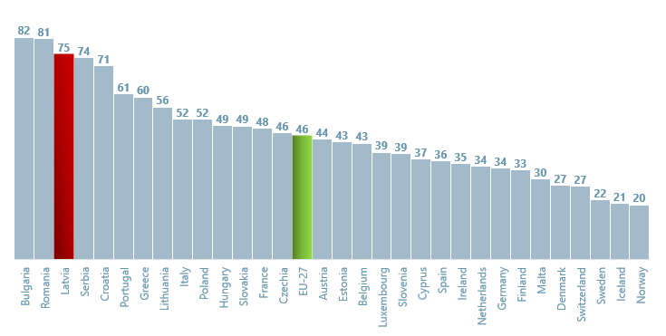
Where we are in EU?
Fatalities per million inhabitants in EU Member States (2023)*
*preliminary data
Notes:
In recent years, Latvia has consistently ranked among the top five EU countries with the highest road fatality rates per million inhabitants, recording 76 fatalities in 2023. Despite ongoing efforts, there has been no decrease in traffic accident-related deaths and serious injuries. This trend is also concerning for vulnerable road users (VRUs), whose rates of severe injuries and fatalities remain notably high without any apparent improvement.
In the short term, we face the same challenges as other EU countries: a shortage of new drivers, a high number of older drivers in the road transport industry, police capacity issues, drunk driving, challenges related to new micromobility tools, aging vehicle fleets, and other similar issues.
The average EU indicator in 2023 was also 46 dead persons per million inhabitants, however, there are still member states where this figure exceeds 80 persons per million inhabitants, as well as there are countries where the number of persons is not higher than 30 persons per million inhabitants.
In general, in 2023, most EU member states had less than 55 deaths per million inhabitants, while 10 EU member states had less than 35 deaths per million inhabitants. In Latvia in 2023, there were 75 deaths per million inhabitants.
Source of information: European Transport Safety Council https://etsc.eu/18th-annual-road-safety-performance-index-pin-report/

Slide 4
LV road fatalities + activities
Special funding from ensurance (campaigns, education e.t.c)
50 km/h in the cities + Daytime Running Lights
Penalty point system + «black spots»
Average speed cameras
Renewed speed cameras
Notes:
We can see a roller coaster last 3 years..
So By looking back in the history, you can see that We are somehow slowly climbing down the hill. With this hill I mean the year 1991 when almost one tousant persons (923 persons) lost their lives in the road traffic accidents, but now – after almost 30 years this number is about one hundred. Of course, this can not be compared to the statistics 30 years ago, but in Ten year period we can say, that 50% drop is reachable target, but will it reach 50 % in the reality?
So then analyzing this ten-year period from 2010 , the number of fatalities has gradually decreased, except for the increase in 2014 and 2018, which could be partly explained by the fact that in 2014 the use of stationary speed cameras on Latvian roads was stopped for some time as we changed the concept of traffic control with speed cameras.
Now we can see, how some of the activities might or might not have any impact on our statistics – in the mid 90s we have introduced speed limit 50 km/h in the cities, as before it was 60 km/h/. Then there was a regulation foe daytime running lights in order to improve visibility. Then in the next decade there was and introducion of penalty points, road safety funding and introduction of road traffic safety campaign. Just to explain – we have our national party – Midsummer eve and in the 2000. there was a tragical night, where we had 26 casualties during Midsummer eve, most of the cases – drunk driving!!! This was somehow national tragedy and after some years we have improved this with campaigns – for example – in last years there were almost no casualties durng Midsummer evw. Then next decade – was introduction of stationary and mobile speed cameras – but due to some political and problems with procurement there was a situation, when all mobile and stationary speed cameras where removed. - we can clearly see this in the statistics!! And of course Improvements (rebuilding) in «black spots» We don’t like to say – «black spots» - because you should not call some place as a «black spot», but make it safe. But anyway – we are also improving the safety in the places, where heavy road traffic accidents often occur.
For the last decade situation is also going up and down – this might have some impacts from Covid – 19, lack of funding for safe infrastructure, lack of speed control, increase of traffic intensity e.t.c . So in the 2023 there were 75 casulaties per one million.
So then analyzing this ten-year period from 2010 , the number of fatalities has gradually decreased, except for the increase in 2014 and 2018, which could be partly explained by the fact that in 2014 the use of stationary speed cameras on Latvian roads was stopped for some time as we changed the concept of traffic control with speed cameras.

Slide 5
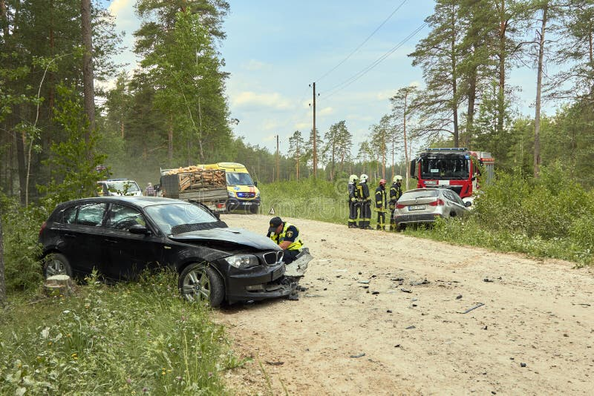
LV Road traffic accidents – year 2024 so far
*raw data https://www.csdd.lv/celu-satiksmes-negadijumi/ikmenesa-dati
Fatalities on roads 01.January – 09.September*

Slide 6













Road Traffic Safety Council
General tasks:
Coordination of road traffic safety policy
Take decisions regarding the use of special funding for measures
MEMBERS:
THINK TANK
Platform for expert meetings to create and comprehensively evaluate new initiatives
Notes:
One of the most important part of our policy planning is the Road traffic safety council
This is A consultative institution,
In this institution senior officials involved in road safety decision-making are represented
Members: minister of Transport, minister of Interior, experts from other ministries and institutions (related to state finances, education, law, health, infrastructure, car safety, rescue, police e.t.c. ) and NGOs.
General tasks:
Coordination of road traffic safety policy
Examine new proposals and measures and decide on most valuable measures
Take decisions regarding the use of funds* for measures
*in accordance with Law on Compulsory Motor Third Party Liability Insurance.
Because the council consists mostly from senoir officials and decision makers, we have also created and expert meeting platform.
So This think tank was created about 5 years ago as a specific discussion platform for experts – any expert can be invited to the discussion, whether it’s expert of hunting – discussion about animals on the roads, expert from health care – discussion about trauma clasifitation, expert from probation service – discussion about drunk drivers and penalty policy
The format of think Tank allows more time to be devoted to the discussion of policy solutions and analysis of best practices.
We have had so far a lot of productive discussions , here I can mention few of them:
More stricte regulations for vehicle winter tires - adopted for truck and cars.
Guidelines for automated vehicle testing - as there was a request from the industry
Regulation for electric scooters -this regulation is now in the parlament already and wiill entry in to force next year.
Urban speed limits 30 km/h - upcoming trend, which can really help to improve safety in cities.
Road traffic control (Point to point radars , red light control) - as the result there are now some pilotprojects in the progress now.
Annual road safety campaign programm (drunk driving, mobile usage, speeding e.t.c.) – in the begining of every year we have a discussion – whqt kind of campaign are needed this season.
Implementation of new standarts and systems (MAIS3+, RTA analyzing tools e.t.c.)
Implementation of Vision Zero concept and Safe System concept - all up to date and important policies are also in the Think Tank Agenda

Slide 7




Road traffic safety plan 2021 - 2027
Focus on factors that directly affect road safety:
→ person (road user)
→ vehicle (technical condition and equipment)
environment (road infrastructure).
General directions:
Implementation of KPIs of Road Traffic Safety
Implementation of Vision Zero measures
Adoption of most appropriate scenario for Latvia
Notes:
Existing road traffic safety policy planning document - Road traffic safety plan 2021 – 2027
Focus on factors that directly affect road safety:
→ person (road user)
→ vehicle (technical condition and equipment)
→ environment (road infrastructure).
General directions:
Implementation of Key Performance Indicators (KPI) of Road Traffic Safety
Focus on safe vehicles driven on safe roads by safe drivers
Implementation of Vision Zero measures
Adoption of most appropriate scenario for Latvia
New concept for road traffic control measures
Fleet (cars) renewal measures
Focus on targeted road safety campaigns (right on time – problem? Campaign!)
International planning documents and strategies taken into account in the development of the plan:
Stockholm Declaration 2020
ITF OECD Road Safety Reports (2019/2020)
UN Decade of Action for Road Safety 2021-2030
Road Safety Policy Guidelines 2021-2030 - The Next Steps to a Zero Vision
White Paper «Roadmap to a Single European Transport Area - Towards a competitive and resource efficient transport system»
A strategy for sustainable and smart mobility

Slide 8
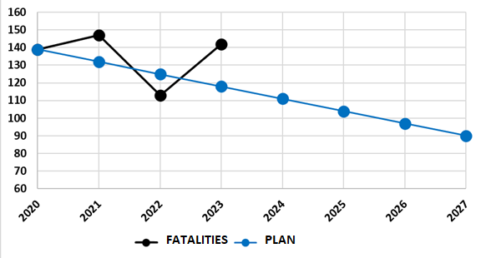
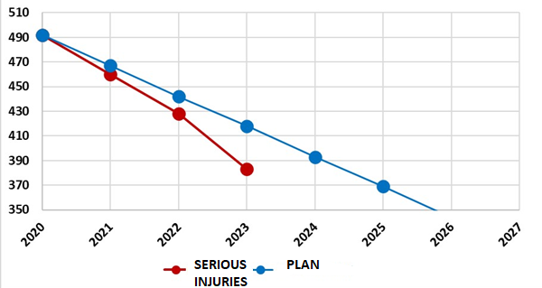
Plan and results:
50 % reduction targets - overview
Fatalities Seriously injured
Notes:
Whats here?
As we have common targets in EU level – 50 % reduction, you can see here the results in last years
Here we have also two graphs – road fatalities and
2020 – 139, 2021 – 147, 2022 – 113, 2023 – 142.
In 2020, 139 deaths to target in 92 persons in 2027, and further to 70 persons in 2030 within 10 years. It must be admitted that the goal was not met in 2021 (147 deaths), 2022 (113 deaths) and 2023 (142 deaths)
Serious injuries: 2020 – 492, 2021 - 460 , 2022 – 428, 2023 - 383 .

Slide 9

Interim impact assesment of the Road Traffic Safety Plan for 2021-2027
→ focus on speeding!
New initiatives are needed to achieve the goal!
Result – new ideas generated in expert groups, Think Tank and from studies:
Cancellation of «+10 km/h» speed tolerance
Expand technical control (radars, average speed e.t.c)
Implementation of RTA investigation
Driver fatigue research (causes and effects)
Improvements in the training of new drivers
Guidelines and recommendations for road designers
Discussion – confiscation of vehicle – dangerous defects + violations for driver
Improvements in road infrastructure (roadsides, safety at intersections, left turns, etc.)
Behavior correction courses for drunk drivers (+confiscation of vehicle for drunk drivers)
Micromobility - registration of electric scooters, helmets, speed e.t.c
- Improvements in Penalty point system
- Reduce the risks from violators – higher price for insurance
Notes:
Interim impact assessment provides an overview of the progress in implementing the Road Traffic Safety Plan for 2021-2027 and its impact on road safety until 2025.
The assessment analyzes the key action directions specified in the Plan, their implementation results, as well as identifies challenges and opportunities for further improvements in road traffic safety.
The document includes an analysis of road traffic accident statistics, an evaluation of road infrastructure conditions, and an assessment of behavioral changes among road traffic participants.
The assessment incorporates about 30 new measures to enhance road traffic safety, categorized by priority (high, medium, long-term) and operational focus – safe road users, safe vehicles, and a safe environment.
A particularly characteristic problem in Latvia is the decision made ten years ago to cancel the monetary penalty in favor of a warning for exceeding the speed limit by up to 10 km/h. This has led some drivers to disregard minor speeding violations. Unfortunately, both research and road measurements indicate that most of the traffic exceeds the permitted speed by up to 10 km/h. This behavior negatively impacts road safety.
Road trafic safety in Latvia
Advancing Road Safety in Latvia: Strategic Initiatives for Reducing Accidents and Enhancing Public Safety
In recent years, Latvia has consistently ranked among the top five EU countries with the highest road fatality rates per million inhabitants, recording 76 fatalities in 2023. Despite ongoing efforts, there has been no decrease in traffic accident-related deaths and serious injuries. This trend is also concerning for vulnerable road users (VRUs), whose rates of severe injuries and fatalities remain notably high without any apparent improvement.
Although the Road Safety Council supports various activities every year—campaigns, studies, individual infrastructure projects, and the purchase of technical and control devices (with an average funding of around 2 million EUR per year)—these measures often have only specific, targeted, and short-term impacts. Measures such as road reconstruction, including in some cases the most expensive solution of separating opposite lanes, cannot be financed from these funding sources. Nevertheless, several projects have been successfully implemented with the Council's funding, such as the introduction of average speed cameras, targeted campaigns (e.g., about driving under the influence), and several studies (e.g., the impact of speed on road safety).
It should also be understood that the existing road network, although regularly improved, does not always meet the safety requirements applicable to modern traffic intensity. Therefore, the partial transfer of domestic cargo from roads to railways should be evaluated. This need is evidenced by recent traffic accident statistics, which include several incidents involving trucks, including head-on collisions and rollovers where only trucks were involved.
A particularly characteristic problem in Latvia is the decision made ten years ago to cancel the monetary penalty in favor of a warning for exceeding the speed limit by up to 10 km/h. This has led some drivers to disregard minor speeding violations. Unfortunately, both research and road measurements indicate that most of the traffic exceeds the permitted speed by up to 10 km/h. This behavior negatively impacts road safety.
The Ministry of Transport has pushed several times in recent years to cancel the warning and impose fines for such transgressions. However, this is an unpopular decision and difficult to gain support for in the coalition. Nonetheless, the Ministry continues to promote this initiative as an important short-term measure.
Although speed is not the only or main factor in traffic accidents, it always exacerbates the severity of the consequences. Research from Riga Technical University supports the internationally proven hypotheses about the impact of speed on accidents and their outcomes. We hope that these arguments will help gain coalition support for this proposal.
At the same time, we are aware that other activities are necessary, including infrastructure improvements. This is a long-term project and cannot be completed in just a few years. Plans include converting certain road sections to separated carriageways. For example, last year, the first private-public partnership project was implemented, creating the Ķekava bypass road as a high-speed highway.
In the short term, we face the same challenges as other EU countries: a shortage of new drivers, a high number of older drivers in the road transport industry, police capacity issues, drunk driving, challenges related to new micromobility tools, aging vehicle fleets, and other similar issues.
We believe it is important and beneficial to exchange experiences, as we often face similar issues. Therefore, we follow trends in other countries and this year, Latvia has joined the OECD ITF IRTAD family, a group of road safety experts and implementers.

Slide 10

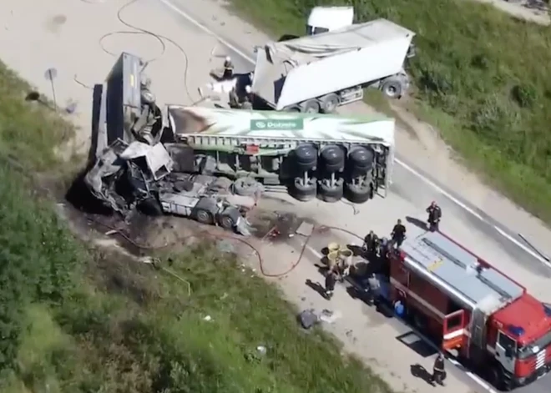

In-depth investigation of fatal accidents
Pilot project in 2024 to create a basis for future systematical approach
Sources of information:
Information from scene of the accident (expert group)
Criminal case materials (including police protocols, descriptions,
schemes e.t.c)
Explanations of RTA participants and witnesses
Photo, video materials
Other relevant materials from police investigation
Information from various institutions:
-Expert views
-Forensic and medical institutions
-Car crash data/analysis
Notes:
The aim of the study is to draw scientifically based conclusions about the most frequent objective causes of serious accidents, as well as to draw conclusions based on the results of the analysis, for the development of safe infrastructure and the improvement of traffic flow safety.The research includes two independent parts, one of which is carried out by CSDD, the other by RTU.The focus of the RTU part is to detail and clarify the causes of heavy traffic accidents and identify critical parameters in the traffic infrastructure and traffic processes with the help of in-depth data analysis. Both publicly available data are used in the research, as well as those obtained directly from the holders of CSNg files and by conducting an additional study of the CSNg site. Statistical analysis tools and artificial intelligence methods are used as analysis tools.

Slide 11






Drunk driving and behavior correction courses for drunk drivers
high public danger - endangers not only
self, but others
Correctional group lessons:
Must attend in full
16 lessons, optimally 6-8 participants
Lessons for a fee
Topics:
1. Motivation lesson. Personality and behavior
2. Habit, habit, addiction.
3. Addictive substances, their effects.
4. Thinking errors. Causes and effects
5. Management of emotions, behavior and stress.
6. Problem solving strategy.
7. Summary. Main conclusions
Solution - not only punishing the violator
No addict → must participate in
correction program
Target → change a person's thinking
and understanding.
Notes:
The goal is a new service that will ensure that drivers who have been punished for driving under the influence of alcohol or narcotic or other intoxicating substances and who are not found to have excessive, harmful use or addiction to alcohol, narcotic or psychotropic substances during the pre-term medical examination, upon regaining their right to drive, it will be mandatory to attend special classes aimed at correcting the person's behavior

Slide 12
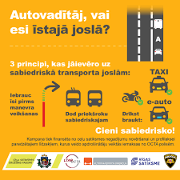


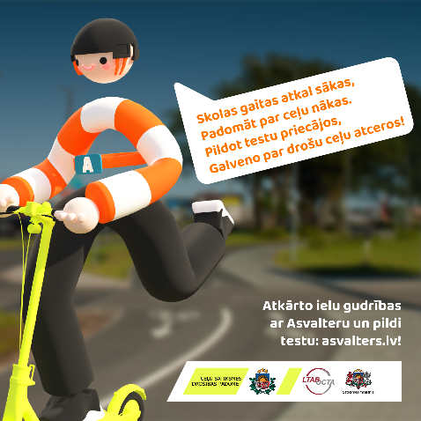
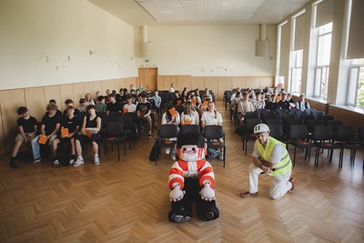
Campaigns
Road Traffic Safety Council funding for campaigns – planning every year, focusing on:
speeding, drunk driving, safety for vulnerable road users, safety in public transport, safe reaction after accident, safe micromobility e.t.c
Campaign «Laid kā lielais» with character ASVALTERS – Mi:t&Links award*
‘ *leading annual communication contest in Baltic Sea region
Notes:
Par kampaņu
Kampaņa “Laid kā lielais!” vērš uzmanību uz bērnu un jauniešu drošu iekļaušanos satiksmē. Kampaņas tēls Asvalters aicina bērnus un jauniešus, viņu vecākus, aizbildņus un pedagogus atkārtot un pārrunāt ceļu satiksmes noteikumus, izmantojot mikromobilitātes rīkus (skrejriteni, elektroskrejriteni, velosipēdu, skrituļslidas un skrituļdēli), kā arī atcerēties par aizsargelementu – ķiveres un atstarotāju – lietošanu.
Pētījumā*, ko realizēja Satiksmes ministrija, noskaidrots, ka par lielāko drošības risku ceļu satiksmē, pārvietojoties ar mikromobilitātes rīkiem, 58% respondentu norāda viedierīču lietošanu, 56% – aizsargelementu nelietošanu un 41% – luksoforu signālu ignorēšanu.
Asvalters aicina – kad būsi atkārtojis ceļu satiksmes noteikumus, pārbaudi savas zināšanas un aizpildi testu par ielu gudrībām.

Slide 13



Annual Road Traffic Safety Index and
Safest Company Car Fleet award
Road traffic safety award 2023
Safest city: Safest municipality:
1. Ventspils 1.Valka
Safest company car fleet award
Annual Road Traffic Safety Index
To create a healthy competition between
municipalities and promote good practices
To encourage fleet managers to create a safe company fleet and promote good practices in their management
Categories:
-Passenger carriers
-Local (Baltic) freight carriers and special purpose vehicle fleets
-International cargo carriers
-Lower risk, state and municipal fleets
Notes:
we clearly also understand that the widest possible range of participants must be involved in ensuring road traffic safety - whether they are municipalities, the residents themselves, as well as businessmen, car carriers, car companies.Therefore, for the eleventh time, the safest companies were identified and awards were presented to the safest company's car fleet - thereby promoting awareness of safe traffic among entrepreneurs and drivers themselves. The insurance company has been implementing this competition for several years in cooperation with the Ministry of Transport, thus involving as wide a range of participants as possible. The biggest benefit is, of course, that traffic safety is being discussed, both company managers and motorists themselves are talking about it.Also, for the third year now, the Ministry of Transport is holding a competition and announcing the safest cities and municipalities in road traffic. accident statistics are the main factor in this competition, but the citizens' opinion is also evaluated as an additional factor. In our opinion, healthy competition can also be promoted in this way, because competing for the title of the safest city or municipality creates safer solutions, and we all benefit.
2023. gada ceļu satiksmei drošākās pašvaldības – Ventspils un Valkas novads
Lai noskaidrotu ceļu satiksmei drošākās valstspilsētas un novadus, Satiksmes ministrija trešo gadu pēc kārtas rīkoja konkursu “Ceļu satiksmes drošības pašvaldību novērtēšanas indekss 2023”. Balstoties uz pašvaldības iedzīvotāju viedokli, ceļu satiksmes negadījumu (CSNg) statistiku un mikromobilitātes novērtējumu, par ceļu satiksmei drošāko valstspilsētu Latvijā 2023. gadā tika atzīta Ventspils, no 36 novadiem pirmajā vietā ierindojies Valkas novads.
Šogad pirmo reizi tika piešķirta atzinība iedzīvotājiem draudzīgākajai valstspilsētai un novadam no piekļūstamības viedokļa, kuru saņēma Rīga un Ludzas novads.
"Ceļu satiksmes drošība ir prioritāte gan valsts, gan pašvaldību līmenī. Šajā konkursā ne tikai novērtējam paveikto, bet arī izceļam jomas, kurās nepieciešami papildu uzlabojumi, lai sasniegtu mērķi – līdz 2027. gadam par 35% samazināt ceļu satiksmes negadījumos smagi ievainoto un bojāgājušo skaitu. Mūsu pētījumi un datu analīze parāda, ka ir daudz darāmā, lai panāktu progresu un mazinātu plaisu starp Latviju un citām Eiropas valstīm. Jau tagad mēs īstenojam vairākus steidzamus un ilgtermiņa pasākumus, piemēram, vidējā braukšanas ātruma kontroles radarus un kreiso pagriezienu samazināšanu, lai uzlabotu drošību uz ceļiem. Aicinu ikvienu satiksmes dalībnieku apzināties savu atbildību ceļu satiksmē un aktīvi iesaistīties diskusijās par drošības uzlabošanu. Mūsu kopīgā rīcība ir būtiska, lai samazinātu ceļu satiksmes negadījumu skaitu un izveidotu drošāku vidi visiem," norādīja satiksmes ministrs Kaspars Briškens.
Salīdzinot ar 2022. gada rezultātiem, valstspilsētu kategorijā izmaiņas nav novērotas. Par ceļu satiksmei drošāko valstspilsētu atkārtoti atzīta Ventspils, kas izceļas ar vislabāko CSNg statistiku, visaugstāko iedzīvotāju vērtējumu attiecībā uz ceļu satiksmes drošību un infrastruktūru, kā arī ir saņēmusi otro augstāko mikromobilitātes novērtējumu. Otrajā vietā ierindojusies Rēzekne, savukārt trešo vietu saglabājusi Liepāja.
"..........," saņemot 1. vietas godalgu, sacīja Ventspils pašvaldības pārstāvis.
Novadu kategorijā pirmajā vietā atgriezies 2021. gada indeksa līderis Valkas novads, kas 2022. gadā dalīja 14.-28. vietu ar citiem novadiem. Valkas novads izceļas ar vislabāko statistiku attiecībā uz CSNg. Otro vietu ieguvis Olaines novads, bet trešo vietu ar zemiem CSNg rādītājiem ieguvis Jēkabpils novads.
“........,” uzsver Valkas novada pašvaldības pārstāvis, saņemot 1. vietas apbalvojumu.
Pirmo reizi konkursa vēsturē tika ieviesta jauna disciplīna – piekļūstamība, kuras vērtēšanas kritērijus izstrādāja Latvijas Cilvēku ar īpašām vajadzībām sadarbības organizācijas “Sustento” eksperti. Izskatot, kā pēdējās desmitgades laikā rekonstruētajās ielās pašvaldības ir izveidojušas ietves, gājēju pārejas, nobrauktuves, sabiedriskā transporta pieturas un izvietojušas brīdinājuma zīmes, Rīga tika atzīta par iedzīvotājiem draudzīgāko valstspilsētu no piekļūstamības viedokļa, bet Ludzas novads izcēlās kā līderis starp novadiem. Piekļūstamības izvērtējumu plānots pilnveidot un turpināt arī nākamgad.
“............,” norādīja Gunta Anča, Latvijas Cilvēku ar īpašām vajadzībām sadarbības organizācijas “Sustento” valdes priekšsēdētāja un satiksmes ministra ārštata padomniece piekļūstamības jautājumos.
Konkursā “Ceļu satiksmes drošības pašvaldību novērtēšanas indekss 2023” tika veikta pieejamo CSNg statistikas datu un faktu apkopošana, vērtēšana un analīze, apvienojot tos ar iedzīvotāju aptaujas rezultātiem. Desmit augstāk novērtētajās valstspilsētās un novados žūrija, kuru veido eksperti no Satiksmes ministrijas, VAS “Ceļu satiksmes drošības direkcija” (CSDD) un apvienības “Pilsēta cilvēkiem”, veica mikromobilitātes izvērtējumu, koncentrējoties uz pašvaldību veiktajiem darbiem un risinājumiem ceļu satiksmes drošības uzlabošanai publiskajā ielu tīklā. Pētījumā, kuru 2024. gada jūlijā veica aģentūra "Norstat", viedokli pauda 2006 respondenti visā Latvijā. Konkursa metodoloģija un rezultāti ir pieejami Satiksmes ministrijas tīmekļa vietnē: …..
Satiksmes ministrija konkursu rīko trešo reizi, un tas tiek finansēts no Ceļu satiksmes drošības padomes līdzekļiem.
Iedzīvotāju aptaujas rezultāti un satiksmes drošības novērtējums
Konkursa ietvaros veiktās iedzīvotāju aptaujas par ceļu satiksmes drošību rezultāti liecina, ka iedzīvotāju vērtējums par ceļu satiksmes drošību un ceļu infrastruktūru pašvaldībās 2023. gadā ir palicis gandrīz nemainīgs. Aptauja atklāja, ka 35% Latvijas iedzīvotāju savās pašvaldībās ceļu satiksmē jūtas droši, savukārt puse jeb 50% respondentu satiksmi savā novadā vai pilsētā raksturo kā vidēji drošu. Visnedrošāk satiksmē joprojām jūtas tie, kas ikdienā pārvietojas ar elektroskrejriteni (52%) un velosipēdu (34%), savukārt visdrošāk jūtas vilcienu (96%) un citu sabiedrisko transportlīdzekļu pasažieri (93%). Automašīnu vadītāji ceļu satiksmē lielākoties jūtas droši vai ļoti droši (82%).
Par “Drošākais uzņēmuma autoparks”
Šogad jau vienpadsmito reizi norisinās AAS BALTA (PZU grupa) un Satiksmes ministrijas kopā ar auto nozares pārstāvjiem organizētais konkurss – gada balva “Drošākais uzņēmuma autoparks”. Tās mērķis ir rosināt Latvijas uzņēmumu, valsts iestāžu un pašvaldību izpratni un vajadzību pēc droša uzņēmuma autoparka un veicināt labo praksi to pārvaldībā, kā arī informēt par autotransporta nozares tendencēm, iepazīstināt ar ceļu satiksmes drošību veicinošiem risinājumiem un godināt izcilākos uzņēmumu autoparkus.
Pieteikšanās šī gada konkursam “Drošākais uzņēmuma autoparks” ir noslēgusies un konkursanti aicināti aizpildīt individuāli nosūtītās anketas līdz š.g. 20. oktobrim ieskaitot.
Savukārt klātienē tiksimies jau novembra beigās balvu pasniegšanas ceremonijā un ekspertu diskusijā “Drošas satiksmes ABC: Auto, Bizness, Cilvēks 2023”, šogad īpašu uzmanību veltot tādām tēmām kā kravu pārvadājumi un to kontrole, transporta infrastruktūra Latvijā, autovadītāju veselības un labsajūtas aspekta nozīme drošas ceļu satiksmes veicināšanā u.c.

Slide 14


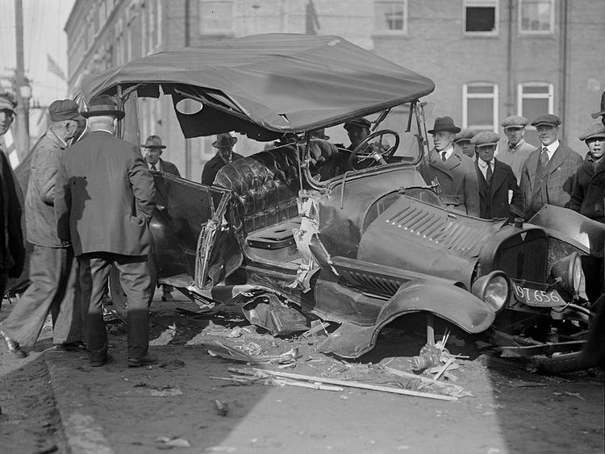


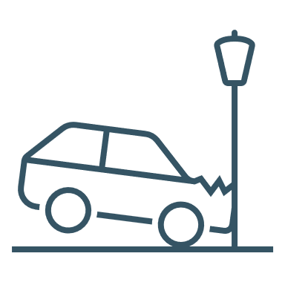
Just 100 years ago..
Same problems!
…are we still facing the same problems??
«Ceļš un satiksme» (1938»)
«.. Beidzamā laikā mūsu satiksmē atkal ir notikušas
vairākas autokatastrofas ar ļoti smagām sekām.
Šo notikumu izmeklēšanas rezultāti ir
pārsteidzoši: tie liecina, ka automobiļus, kuri
katastrofas radījuši, vadījušas iereibušas personas.
Tā tad vienmēr vēl rodas tādi cilvēki, kuri negrib
saprast, ka automobiļa motors nav rotaļas lietiņa,
bet gan spēcīga mašīna, kura pie vieglprātīgas,
aušīgas vadīšanas apdraud kā paša mašīnas vadītāja, tā arī
līdzbraucēju un citu cilvēku dzīvības.»
«Iekšlietu ministrijas Vēstnesis» (1929»)
«.. Ik gadus, pieaugot motorratu skaitam un viņu
kustības ātrumam, ir pieaudzis ari nelaimes
gadījumu skaits… Interesanti ir atzīmēt, ka 35% no visiem
nelaimes gadījumiem pēc Anglijas iestāžu atzinuma ir cēlušies
kājnieku vainas del,.Vispirms komisija atzinusi, ka jāgādā par lielākam
kājnieku ērtībām, un gar visām jaun- un pārbūvējamām
šosejām jāierīko samērīgi trotuāri kājniekiem.
Tāpat, kur vien tas iespējams, ari gar jau pastāvošām šosejām
un lauku ceļiem jāierīko trotuāri...»
Safety for vulnerable road users
Drunk drivers on roads
«Satiksme un Tehnika» (1943»)
«.. Lai noskaidrotu kādu aizdomīgu troksni motorā, līdzbraucējs braukšanas laikā atvēra preču automobiļa durvis. Spēcīgais pretvējš atrāva durvis pilnīgi vaļā, izrāva tās no virām un līdz ar durvīm izrāva arī līdzbraucēju. Pēdējais dabūja ļoti smagus miesas bojājumus — galvas kausa lūzumu un smagu smadzeņu satricinājumu..»
Inadequate passengers
Notes:
https://periodika.lndb.lv/periodika2-viewer/?lang=fr#panel:pa|issue:207751|article:DIVL11
https://periodika.lndb.lv/periodika2-viewer/?lang=fr#panel:pa|issue:30312|article:DIVL75|query:Ce%C4%BCu%20satiksmes%20dro%C5%A1%C4%ABba%20ce%C4%BCu%20dro%C5%A1%C4%ABbu%20
https://periodika.lndb.lv/periodika2-viewer/?lang=fr#panel:pa|issue:30312|article:DIVL75|query:Ce%C4%BCu%20satiksmes%20dro%C5%A1%C4%ABba%20ce%C4%BCu%20dro%C5%A1%C4%ABbu%20

Slide 15
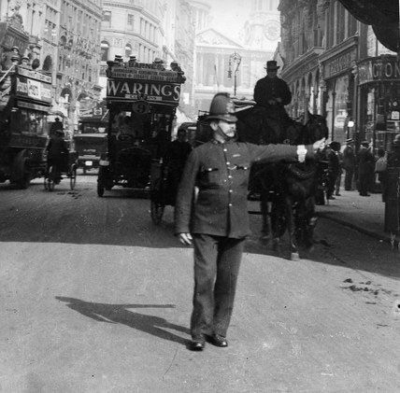
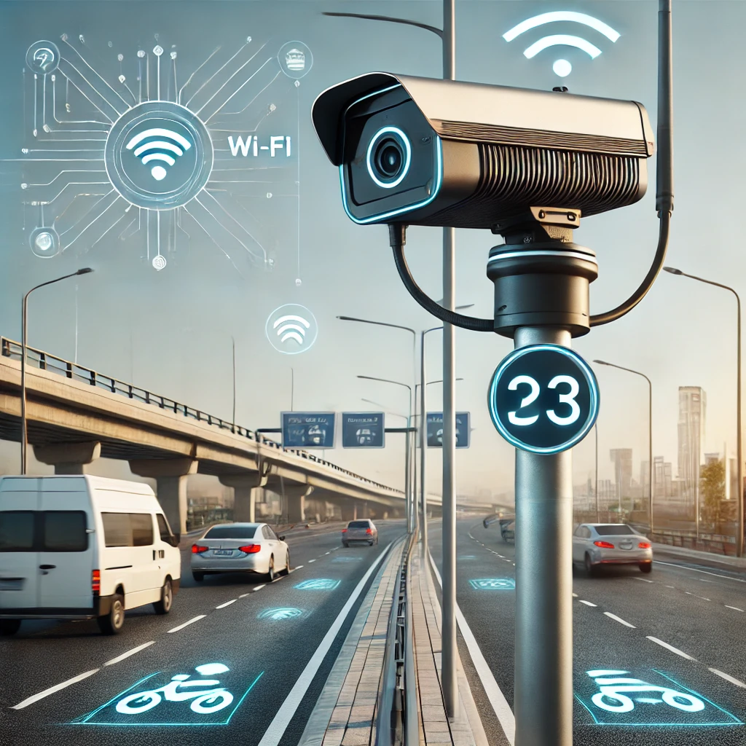
Just 100 years ago and now:
Different solutions!
People will not change, but we can create a system that is safe
Notes:
We all make mistakes, it's natural, so a system should be created that reduces mistakes or prevents their consequences
We can see that people do not want to change their habits, so it will not work without control. however, over a hundred years, we have come a long way with various automated solutions to control these dangerous habits. therefore, I also believe that the further development of technical means in combination with the use of artificial intelligence, including in automated vehicles, will help to make this traffic definitely safer, maybe even completely safe. but time will tell.

Slide 16


